Slide 1
Nuclear Physics
Varan Satchithanandan
Mentor: Dr. Richard Jones

Slide 2
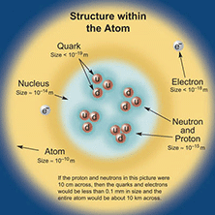
Standard Model
explains what the world is and what holds it together
consists of:
6 quarks
6 leptons
force carrier particles
two types of elementary particles
fermions and bosons
F: obey Pauli Exclusion and have half integer spin
B: do not obey and have integer spin

Slide 3
Quarks
compose protons and neutrons
quarks also have color charge
3 quarks in a group = baryon
1 quark plus 1 anti-quark= meson
Up 2/3 + charge | Top 2/3 + charge | Charm 2/3 + charge
Down 1/3 – charge | Bottom 1/3 – charge | Strange 1/3 – charge

Slide 4
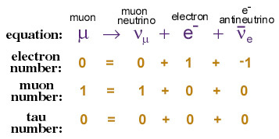
Leptons
3 have charge
electron (e)
muon (μ)
tau (τ)
3 do not
electron neutrino (ν_{e})
muon neutrino (ν_{μ})
tau neutrino (ν_{τ})

Slide 5
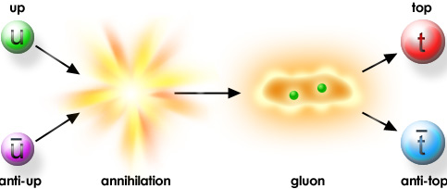
Anti-Matter
every particle of matter has a corresponding anti particle
they look and behave just like their opposites except in charge
e.g. protons (+) antiprotons (–)

Slide 6
Force Carrier Particles: A Background
four fundamental interactions between particles
gravity
electromagnetic
strong
weak
a force is a consequence of interactions between force particles

Slide 7
Electromagnetism
this causes opposite electrical charges to attract and same charges to repel
allows different atoms to bind together
residual electromagnetic force
carrier particle is the photon (γ)
zero mass
travel at light speed
makes up electromagnetic spectrum

Slide 8
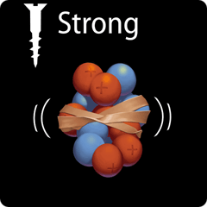
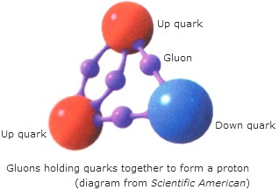
Strong Force
holds quarks together to form hadrons
very powerful
carrier particle is the gluon (g)

Slide 9
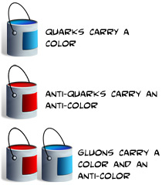
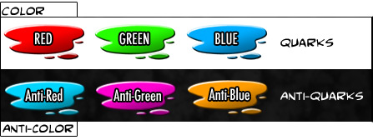
Color Charge
quarks have both electromagnetic charge as well as color charge
gluons have color charge as well
color charged particles exchange gluons in interactions

Slide 10
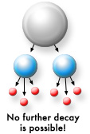
Weak Force
weak interactions result in the decay of massive quarks and leptons
carrier particles are W⁺, W⁻, and Z

Slide 11
Electroweak
Standard Model has united weak and electromagnetic force
at short distances the attraction is roughly equivalent
same under high energy–short distance scale

Slide 12
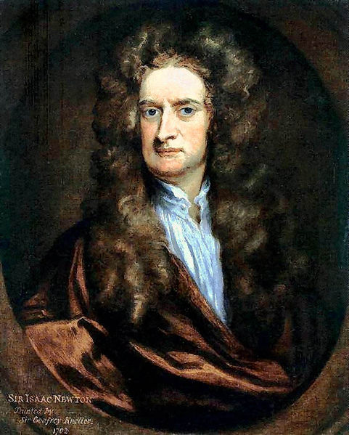
Gravity
SM does not explain
physicists searching for the graviton
force is very small – almost negligible

Slide 13
GlueX
exciting gluonic field generating exotic mesons
understanding the principle of confinement

Slide 14
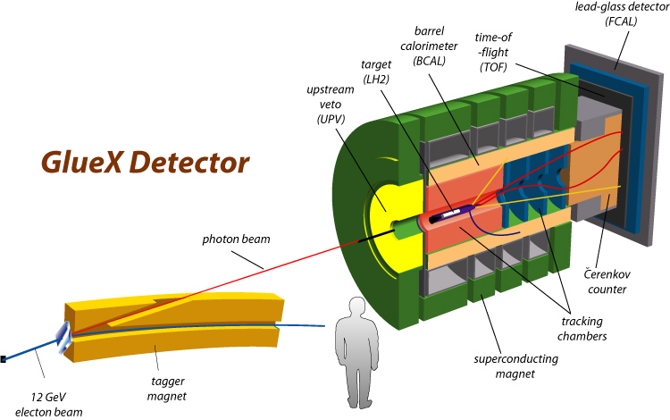
Process

Slide 15
Bremsstrahlung: Introduction
translated: braking radiation
produced by acceleration of charged particle after deflection from another charged particle

Slide 16
Coherent Bremsstrahlung
coherent: multiple particles of the same field involved in a process
two requirements:
multiple atoms
correct angle

Slide 17
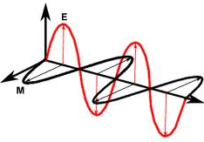
Criteria for Photon Beam
linear polarization
electromagnetic field perpendicular to wave
high energy resolution
ability to take individual photons at high energy
property of detector
low background radiation

Slide 18
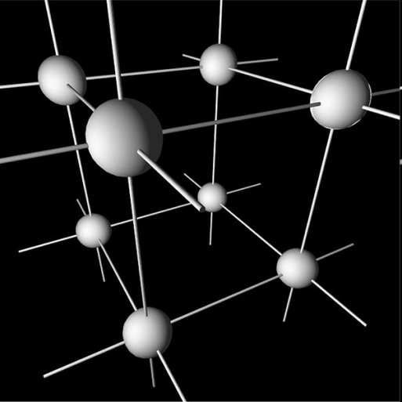
Reciprocal Lattice Vectors
an arrangement of crystalline points

Slide 19
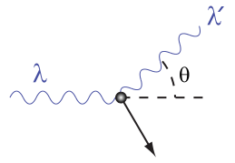
Possible Methods
Compton Scattering
ideal polarization
little background radiation
Bremsstrahlung
energy
flux

Slide 20
Coherent Bremsstrahlung Cot’d
increases flux of photons
low background radiation
linear polarization

Slide 21
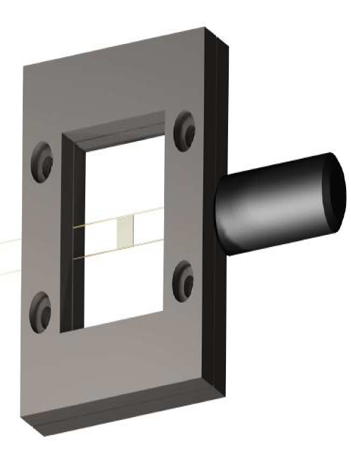
Our Part
crystal is mounted by carbon fiber wires
resonance frequency determined

Slide 22
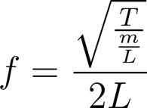
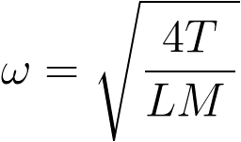
Vibrating String
resonant frequency
tendency to oscillate with a larger amplitude
base must be stable
calculate tension of wires

Slide 23
Theory vs. Data

Slide 24
Conclusion
a review
Standard Model
mathematical concepts
GlueX

