Slide 1
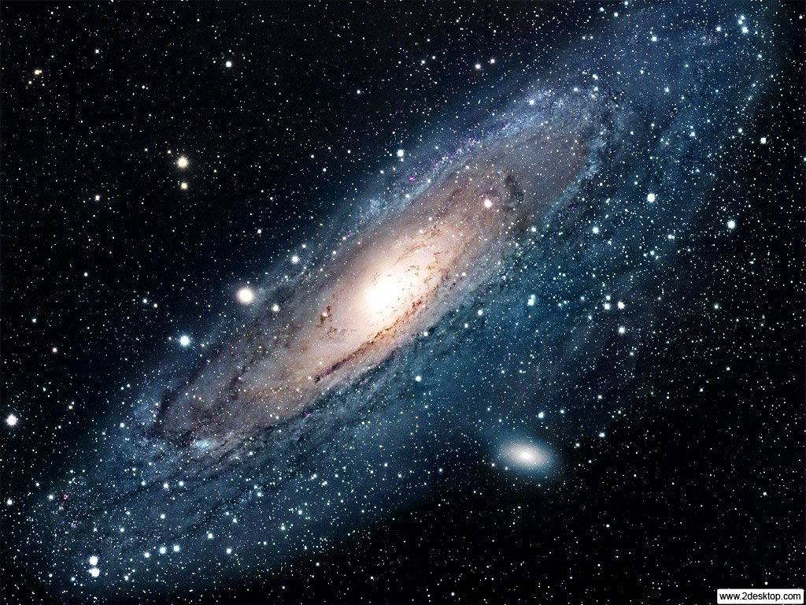
The Other Side of The Universe: Dark Matter
Searching for this elusive substance in the Cosmos
Alex Popescu
Mentor: Dr. Richard T. Jones

Slide 2
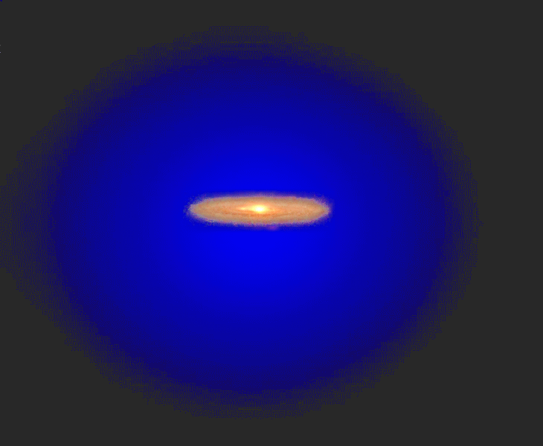
Dark Matter Facts
Baryonic Matter is only 20% of the Universe
80% is Dark Matter
Dark Matter doesn’t interact with light or ordinary matter very frequently.
We have been looking for it since 1933, when Fritz Zwicky predicted it
Dark Matter is a “Perfect Fluid,” meaning its molecules do not transfer heat, and they move around without touching one another.
Dark Matter Halo, 400X more massive

Slide 3
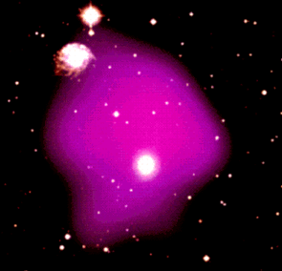
How Do We Know Dark Matter Exists?
Gas Observations “Missing Mass”
Galaxy Mass 400 Times more than stars & Planets
DM
Hot gas in a galaxy cluster,
at ~10 Million degrees K.

Slide 4
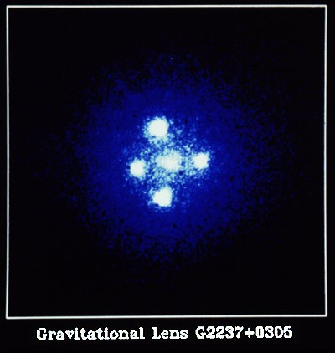
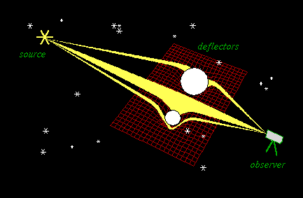
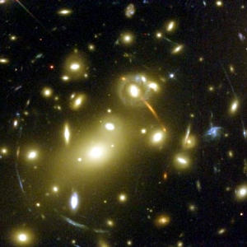
Gravitational Lensing
Un-Aligned
Aligned Observer

Slide 5
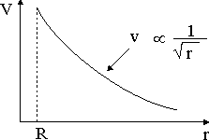
Galaxy Rotation Curves
Our Solar System
G
G
V
V
As Distance from the center of mass increases, velocity decreases.

Slide 6
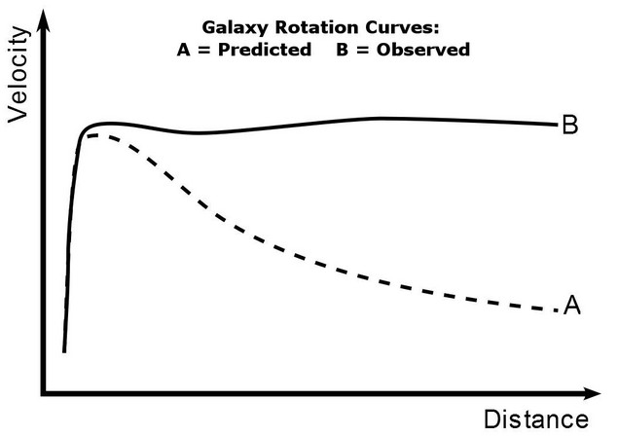
Galaxy Rotation Curves
Stars rotating in a spiral galaxy
In a galaxy, stars rotate at a constant velocity, no matter how far they are from the center.
Without Dark Matter, stars and planets in our galaxy would fly off into space, because they move so fast.
Notes:
Dark Matter must be extra massive, to hold all these planets in orbit

Slide 7
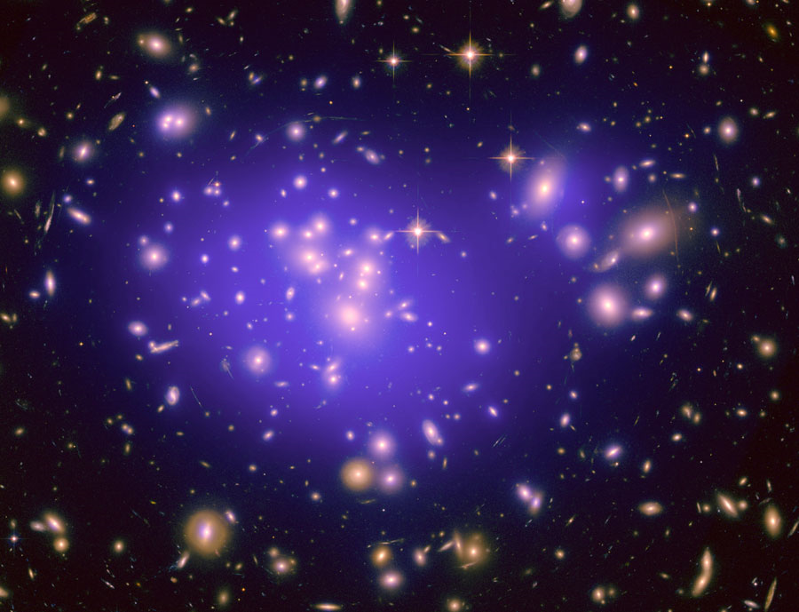
Galaxy Formation
Soon after the big bang, Dark Matter “clumped,” because of strong gravity.
Clumping created Galaxies, and other effects we can see today.
CM Background
Galaxies attract each other, to form Galaxy clusters. (85% of Galaxy clusters are composed of Dark Matter.
Contributes to Large-Scale Structure
A Galaxy Cluster – The Purple is Dark Matter Content
Notes:
Hi-velocity galaxies are very hard to clump, therefore dark matter is needed

Slide 8
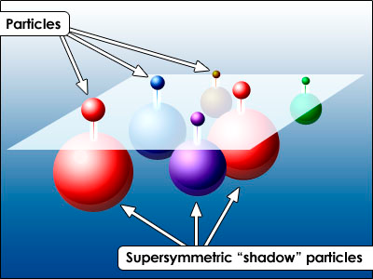
Properties of Cold Dark Matter
Generally accepted that Cold Dark Matter is composed of WIMPs, or Weakly Interacting Massive Particles
Neutralinos are suspected, a Super-Symmetric Particle
No experiment has detected Dark Matter yet, Only set limits for what CDM can’t be.
Notes:
Suspected that Neutralinos, that are the shadow particle of neutrinos, are the candidates for dark matter, because no other particle is massive enough.

Slide 9
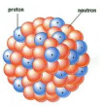
Dark Matter Detection
DM
DM
Direct Detection
Can only Detect head-on collisions, very few events
Scintillation
Ionization
Phonon Detection
Scintillation
Ionization
e-
Photon
An Atom
Notes:
Phonon detection means that elastic vibrations from collision are being measured

Slide 10
Xenon100 Dark Matter Detector
Measures scintillations from Dark Matter Particles
Deep underground
Liquid Xenon Tank
Photomultipliers
Notes:
In a mine in Sudan

Slide 11
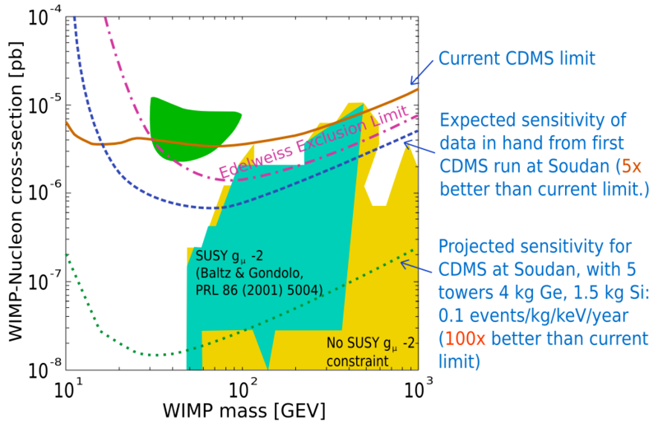
Problems with Direct Detection
Head-on collisions are very rare
Background radiation
Detector sensitivity is low, but improving.
VERY small: 3x10⁻²² cm D.
WIMP particle cross-sectional area vs. WIMP mass
The curves represent the sensitivity to cross-section at different WIMP masses. The shaded-in regions are where WIMPS may exist.
Notes:
Y-axis is in pico-barns, or 1x10^-40 m^2, smaller than a proton

Slide 12
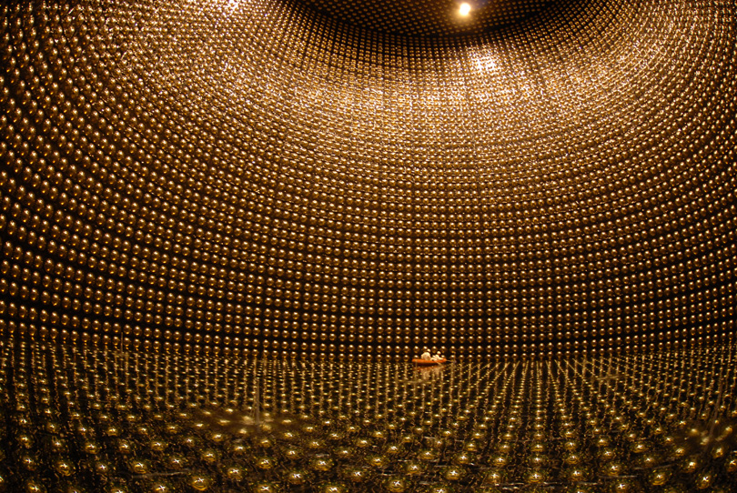
Indirect Detection of WIMPs
Look for evidence of WIMP existence in existing particle interactions.
Ex. Look for gamma rays caused by neutrino annihilation(the neutrino is its own anti-particle).
Look for Neutrinos produced from neutralino annihilation.
Antiprotons, positrons and antideuteron production
A Neutrino Telescope

Slide 13
Indirect Detection of WIMPs
WIMP Wind
Gamma-Ray
Gamma-Ray
Gamma-Ray
Gamma-Ray
Gamma-Ray
Gamma-Ray
Gamma-Ray
Gamma-Ray
Gamma-Ray
Notes:
WIMPs are sucked in by the sun’s massive gravity field

Slide 14
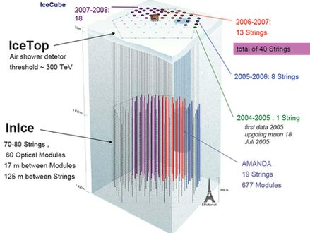
AMANDA Antarctic Detector
Looks for High-energy muons’ scintillation in Antarctic ice
Muons produced in the Earth’s atmosphere from neutrino collisions

Slide 15
Modified Newtonian Gravity
Some physicists believe that Dark Matter is a fabricated idea, and our understanding of gravity is wrong at large distances.
Modified Newtonian Gravity (MON) principles do fit actual data

Slide 16
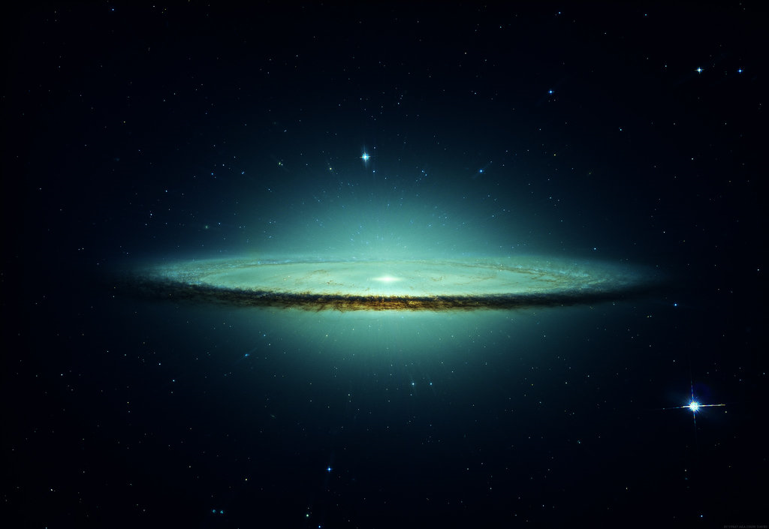
Dark Matter
CRESST at The Gran Sasso Laboratory
CUORE at The Gran Sasso Laboratory
DAMA at The Gran Sasso Laboratory
EDELWEISS au Laboratoire Souterrain de Modane
GENIUS at The Gran Sasso Laboratory
HDMS at The Gran Sasso Laboratory
MACHe3 at the ISN
PICASSO at the U. of Montreal
UK Dark Matter Collaboration at the Boulby Mine
Over a dozen experiments (including the ones shown) are currently being used to find Dark Matter.

Slide 17
Thank You!
A special thank you to Dr. Jones, Dr. Mannheim, Lacey, and Hoon for their help.

Slide 18
Sources Cited
Images:
NASA Images. http://www.2desktop.com/wallpapers/NASA__The_Andromeda_Galaxy_M31_Spyral_Galaxy_2035_1024_768.jpg
http://apod.nasa.gov/apod/ap100824.html
Information:
http://www.astro.virginia.edu/~jh8h/Foundations/Foundations_1/chapter14.html
http://www.astr.ua.edu/keel/galaxies/icm.html
http://imagine.gsfc.nasa.gov/docs/science/know_l1/dark_matter.html
http://www.ifa.hawaii.edu/~ger/ASTRO-110_sp08/Lecture28_DarkMatter.pdf
http://math.ucr.edu/home/baez/physics/Relativity/GR/dark_matter.html
http://arxiv.org/PS_cache/astro-ph/pdf/0504/0504097
http://www.astro.princeton.edu/~dns/MAP/Bahcall/node16.html
http://www.ifm.umich.mx/~raya/papers/AIP-CP1026-195-2008.pdf
http://cdms.berkeley.edu/Education/DMpages/science/directDetection.shtml
http://www.astro.princeton.edu/~dns/MAP/Bahcall/node14.html
http://web.mit.edu/~redingtn/www/netadv/specr/6/node7.html
http://arxiv.org/PS_cache/astro-ph/pdf/0211/0211500v1.pdf
http://physicsworld.com/cws/article/news/25429
http://mckinseygroup.physics.yale.edu/Publications/MiniCLEAN_McKinsey.pdf
http://www.ifm.umich.mx/~raya/papers/AIP-CP1026-195-2008.pdf
http://www.weizmann.ac.il/particle/nir/uploads/file/chapter8.pdf
http://www.phys.uu.nl/~prokopec/RobertKnegjens_dm2.pdf
http://arxiv.org/PS_cache/arxiv/pdf/1106/1106.2529v1.pdf
http://arxiv.org/PS_cache/arxiv/pdf/1102/1102.4585v1.pdf

