Slide 1
Quantum Chromodynamics
Suki Hyman

Slide 2
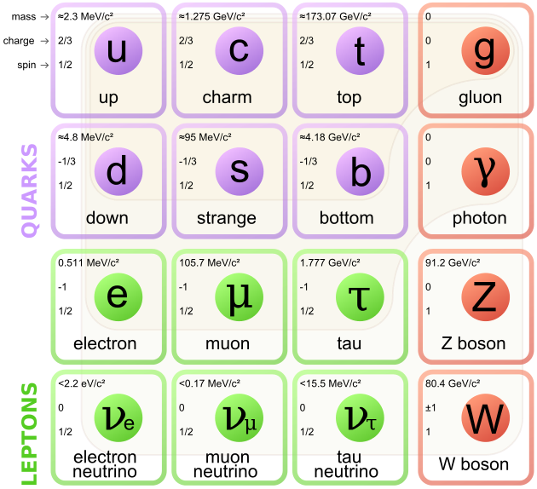
Remember Quarks?
Matter Particles
“Three quarks for muster Mark”
-James Joyce
Force Carrier
1

Slide 3
A Brief History of Quarks...
In 1961 Murray Gell-Mann created a classification scheme for hadrons called The Eightfold Way
In 1964 Murray Gell-Mann postulated the existence of quarks
In 1972 Harald Fritzsch introduced Color Charge as a conserved quantum number
2

Slide 4
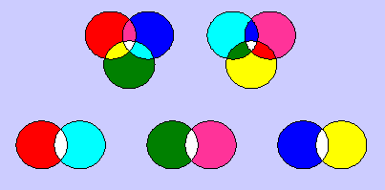
What is QCD?
The Theory of “Strong Interactions”
Gluons and Quarks
Color Charge
Confinement
(Warning:Not actually how they work)
Hadrons
Color Neutral
3

Slide 5
The Strong Force
Visible in two ways:
Residual Nuclear Force: Confining Nucleons
Color neutral pions
1-3 fm
Strong Nuclear Force: Confining Quarks
Color+Anticolor gluons
<0.8 fm
4

Slide 6
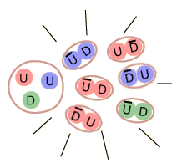
Color Confinement
Quarks are never found in isolation
The Strong Force is too strong to allow a single quark to separate
Only Hadrons have ever been observed
A quark cannot be given enough energy
to separate
+1 GeV per Fermi
5

Slide 7
Types of Hadrons
Simplest forms of color neutral Hadrons
(Bound states of quarks)
Meson- quark+antiquark
Baryon- quark+quark+quark
Simple Quark Model
q
q
q
q
q
6

Slide 8
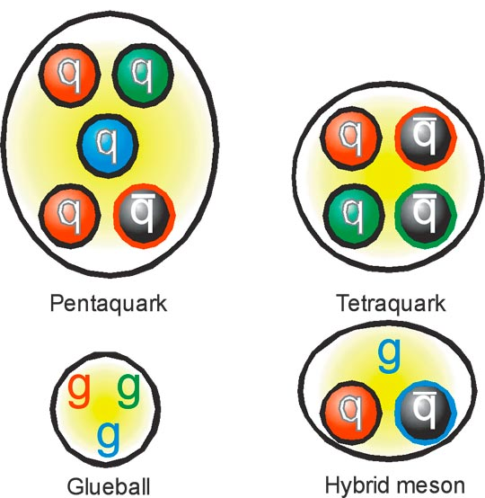
Exotic Bound States
QCD allows other states though
All neutral color states should be allowed
7

Slide 9
The Eightfold Way
Gell-Mann’s system for organizing Hadrons
Scaled by Strangeness and Electric Charge
Strangeness:
Electric: ±2/3 or ±1/3 for each quark ±Integer Values for spin
8

Slide 10
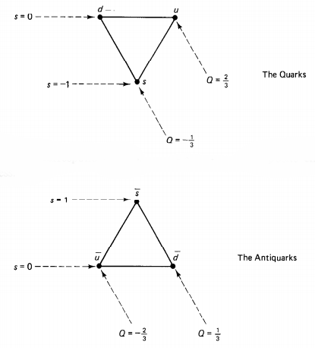
Elements of organization
By arranging
these two
elements one
can create all
Hadrons
allowed by
the Quark Model
9

Slide 11
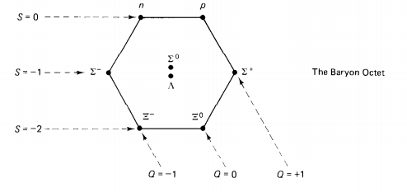
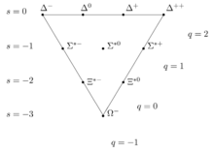
Baryons
Octet:
Lightest Baryons
Decuplet:
Heavier Baryons
10

Slide 12
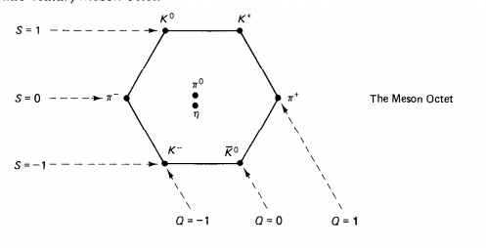
Mesons
Meson Octet:
11

Slide 13
What’s Next?
Experiments are being done to try to detect these exotic states
GlueX Experiment
CERN’s LHCb Experiment
Japan-Belle Experiment
COSY Experiment
etc.
12

Slide 14
Questions

