Slide 1
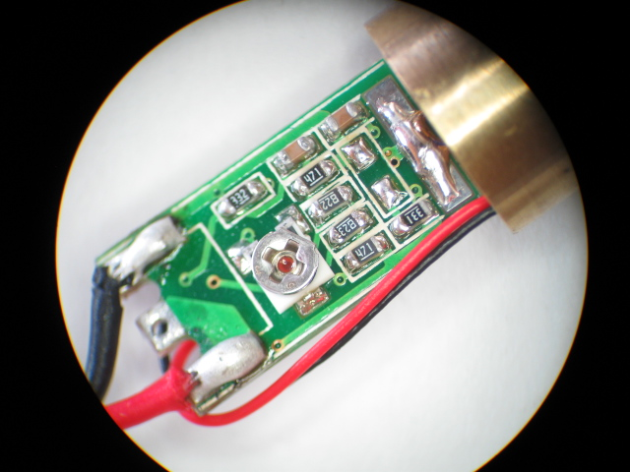
-
+

Slide 2
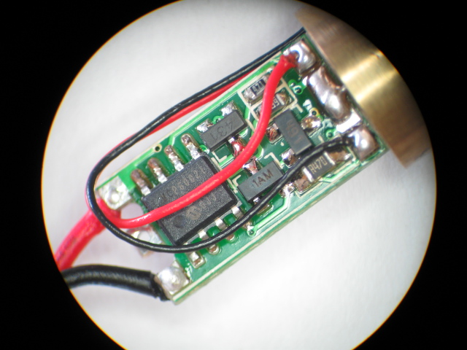
Positive Lead from Photo Sensor
Negative Lead from Photo Sensor

Slide 3
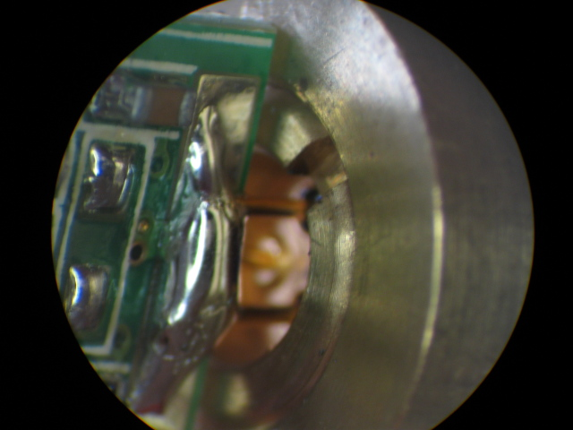
Two pins with black boots soldered to large single pad.

Slide 4
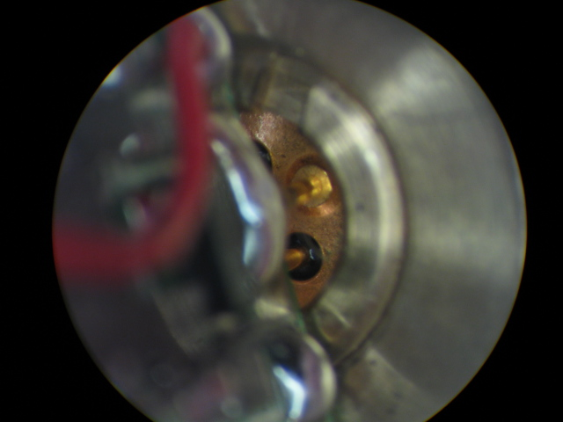
Third pin with gold boot soldered to middle pad in between red and black leads from Photo Sensor

