Slide 1
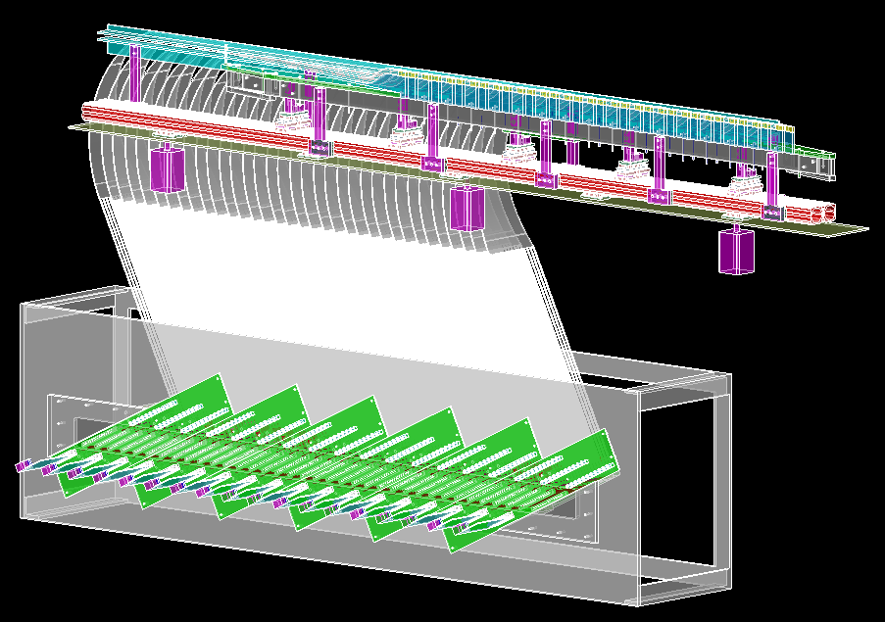
Tagger Microscope Mounting, Shielding & Cooling
James M^{c}Intyre
May 7, 2013

Slide 2
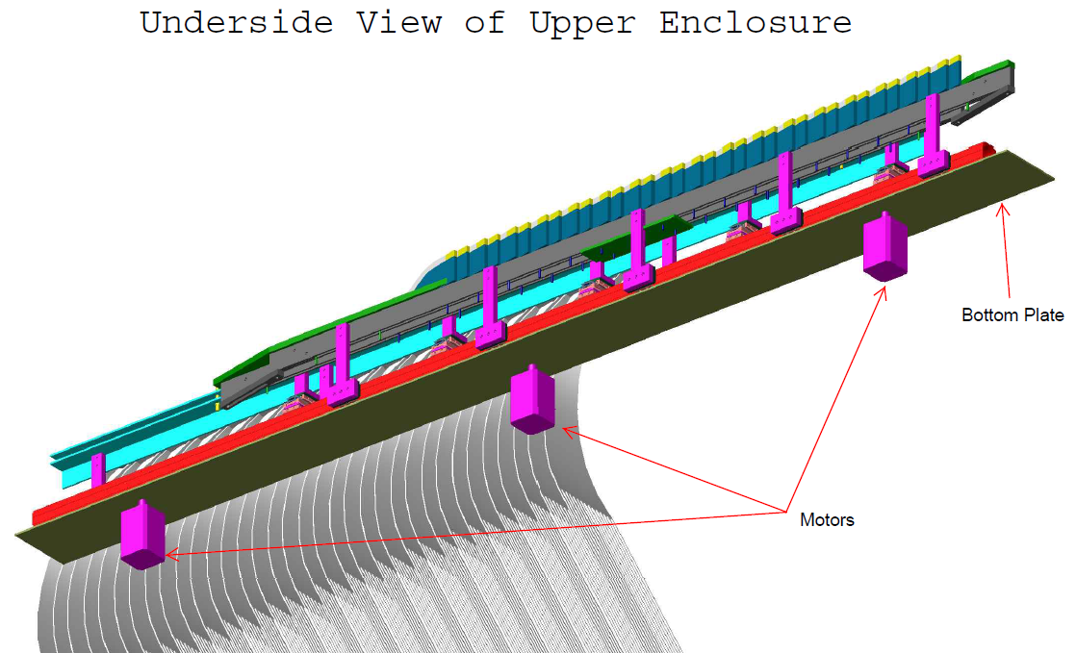
Mounting the Upper Enclosure

Slide 3
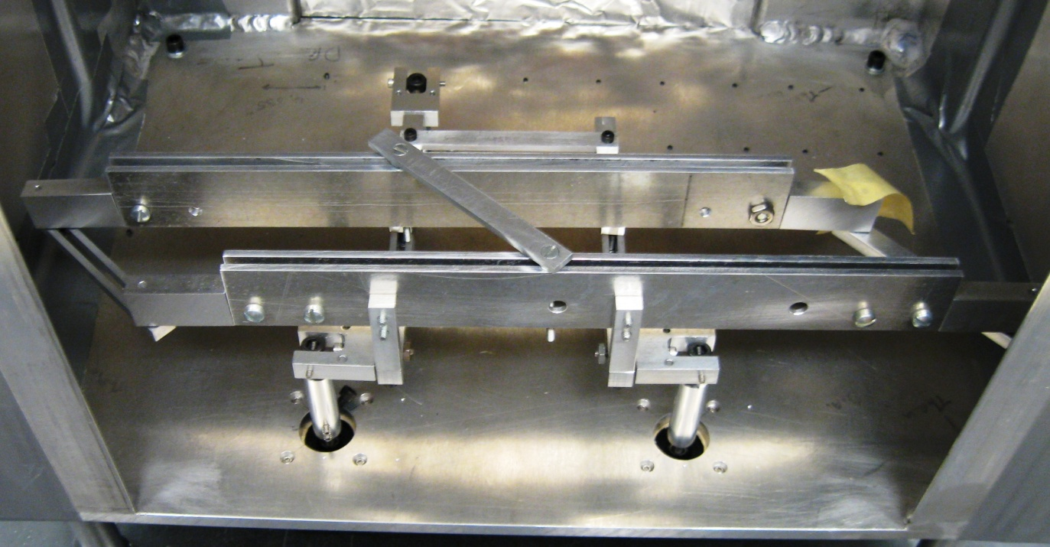
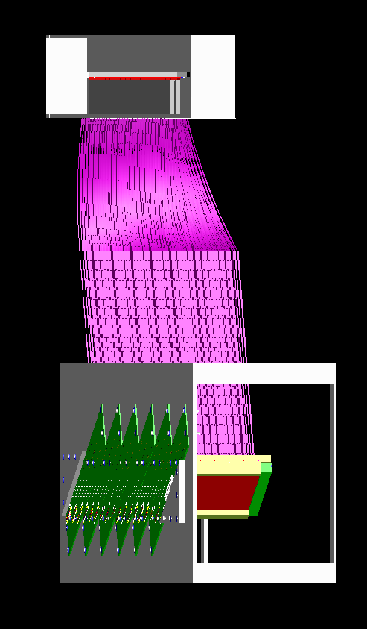
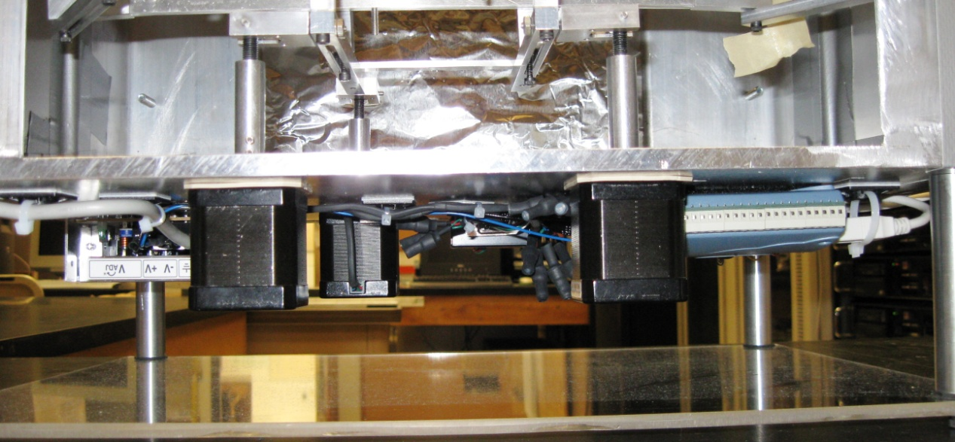
Mounting the Upper Enclosure
The prototype used a c-bracket affixed to a bolt threaded into a cylinder which is attached to a step motor.
The parallel rail system will be mounted to the bottom-plate of the upper enclosure.
The motors are no longer attached to the bottom-plate.
The connections between the motors and upper enclosure bottom-plate (e.g. ball & joint fitting) will serve as the UConn / JLab interface point.

Slide 4
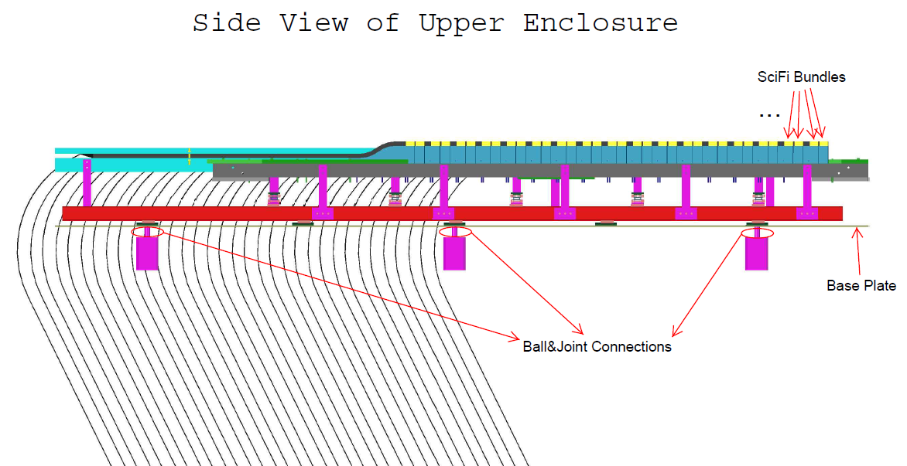
Mounting the Upper Enclosure

Slide 5
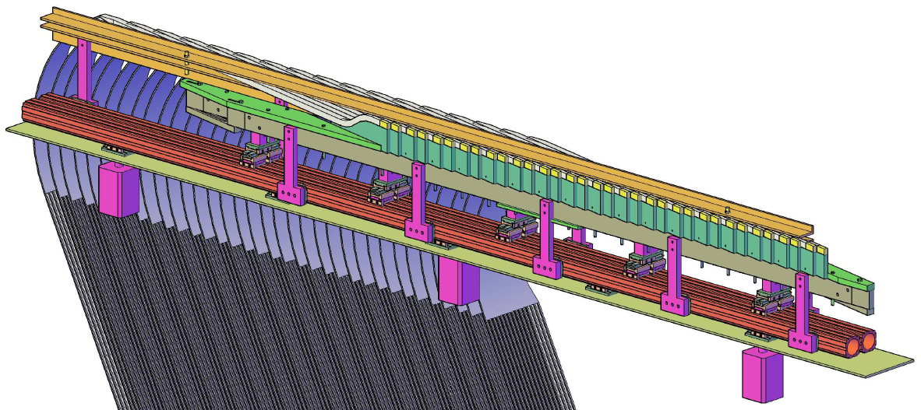
Mounting the Upper Enclosure
Possible locations to mount a marked plate for use by the survey team during installation and alignment.

Slide 6
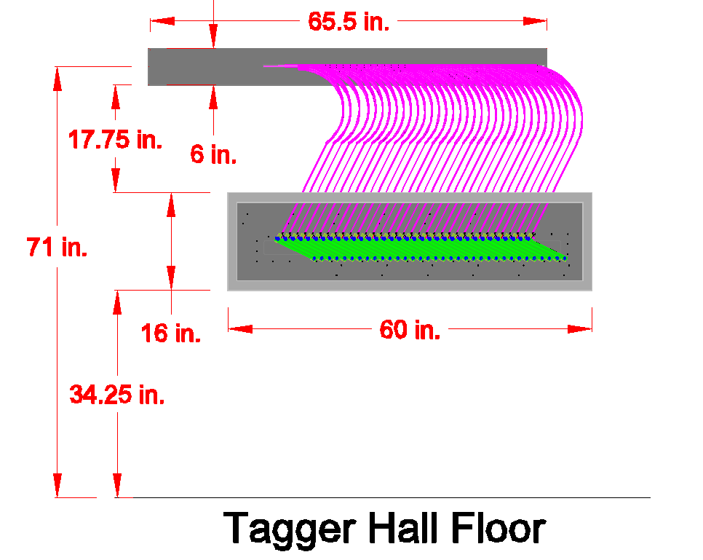
Mounting the Upper Enclosure
XXXXX
XXXX

Slide 7
Mounting the Upper Enclosure

Slide 8
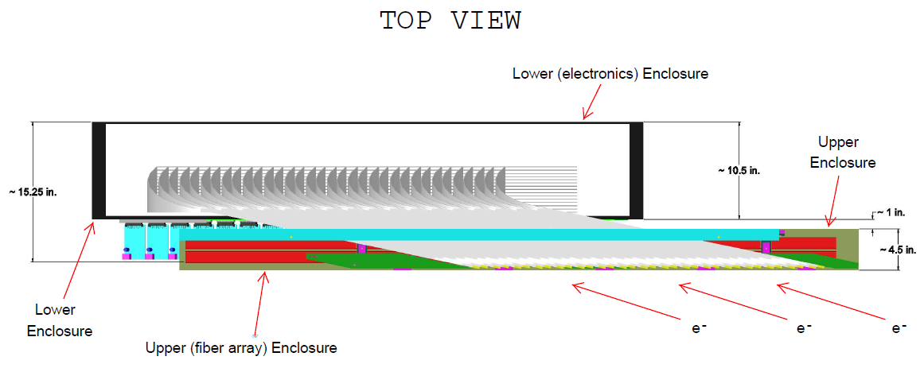
Mounting the Upper Enclosure

Slide 9
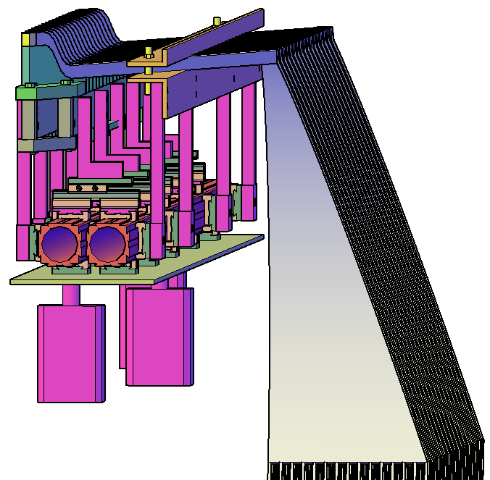
Mounting the Upper Enclosure

Slide 10
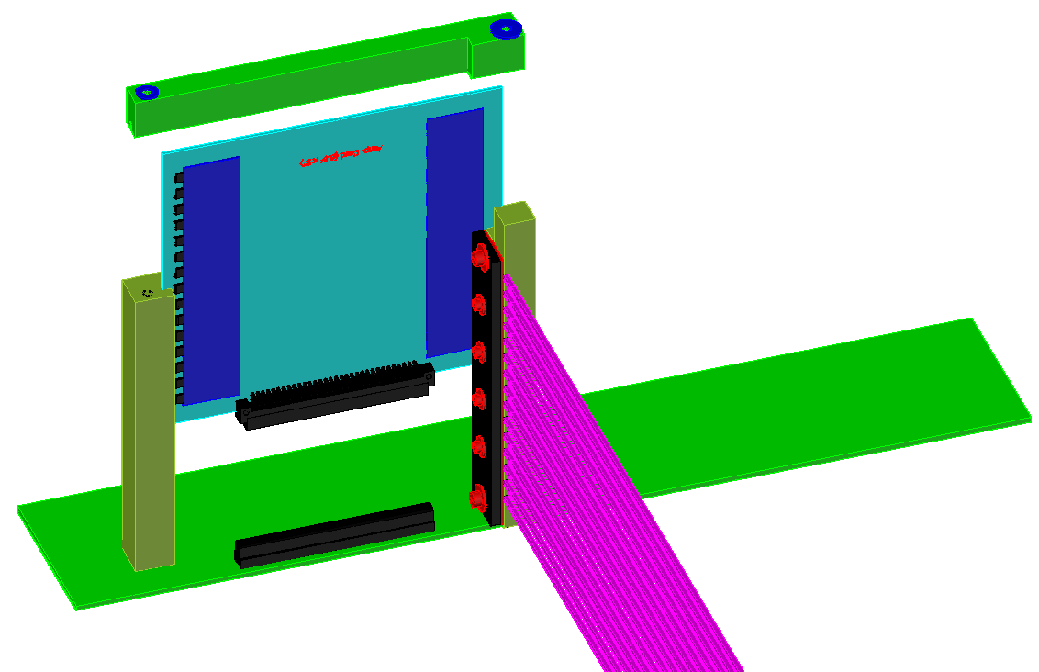
Mounting the Upper Enclosure
Concept Drawing Only

Slide 11
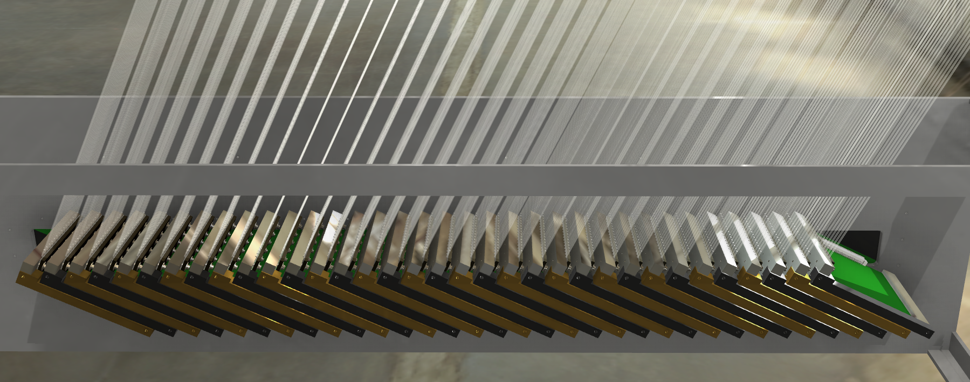
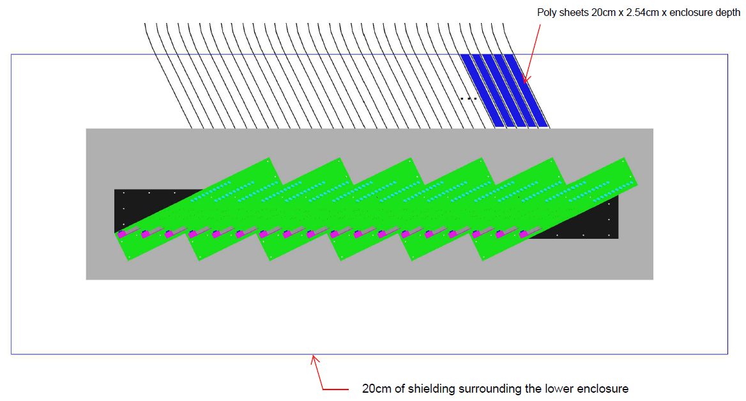
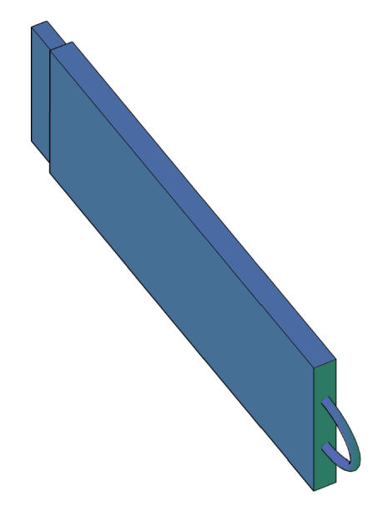
Shielding the Lower (Electronics) Enclosure
The light guides enter the lower enclosure in sheets 15 fibers deep for each preamplifier board.
There is a gap of ~ 1.25 inches between each sheet of fibers.
Need penetrations for cooling water loop & cables.

Slide 12
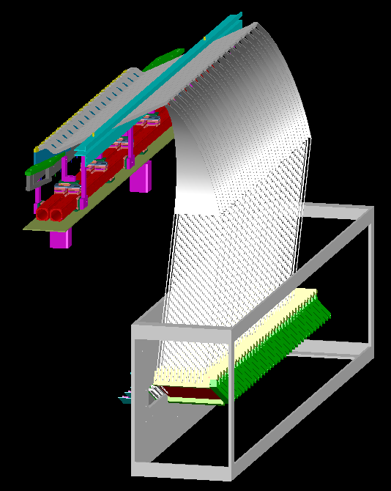
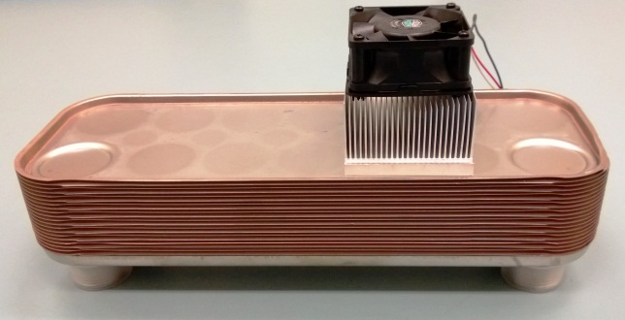
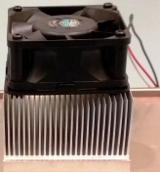
Lower (Electronics) Enclosure Cooling
Looking to remove 60 – 100 Watts.
Use of chilled water (possible chiller unit may be required).
Additional fans mounted in the enclosure to provide adequate air flow.
Also need similar system for between the shielding and the exterior of the lower enclosure.
Enclosure
Cooling Unit (Concept)
Mounted on the side wall

Slide 13
Additional Drawings
Tagger Microscope Technical Drawings
http://zeus.phys.uconn.edu/wiki/index.php/Full_Scale_Tagger_Microscope_Drawings
UConn Student Projects in Nuclear Physics
http://zeus.phys.uconn.edu/wiki/index.php/Student_Projects_in_Nuclear_Physics

