Slide 1
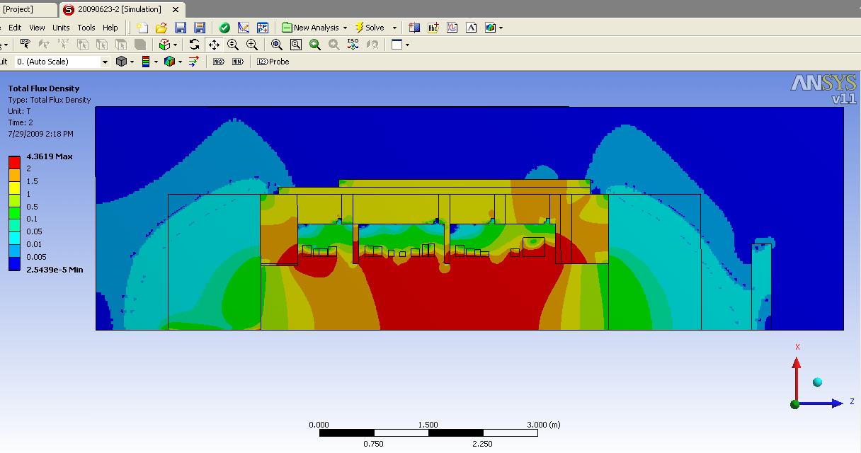
Proposed Design @ 1500Amps
COIL SETUP INFO/Simulation Run # | 20090623-2 (2,2,4 Mesh: Cold, FCAL, CLADDING)
AMPS | 1500
1A | 360.98
1B | -245.35
1C | -57.477
1D | 26.484
1E | 223.49
1F | 120.9
1G | -342.66
1 SUM (k) | 86.377
2A | 379.36
2B | 92.177
2C | -17.396
2D | -417.06
2SUM (k) | 37.073
3A | 216.24
3B | -0.38148
3C | -102.53
3D | -153.46
3SUM (k) | -40.142
4A/B | 535.52
4C/4D | -538.23
4SUM (k) | -2.7075

Slide 2
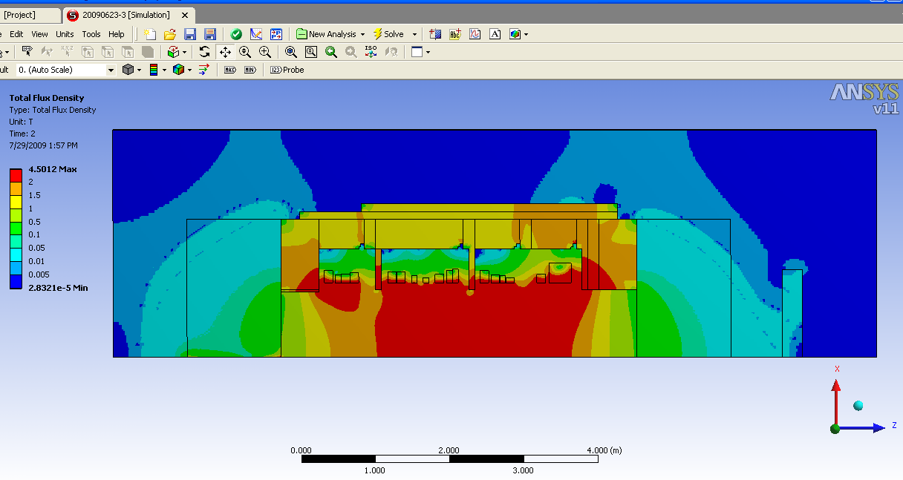
Proposed Design @ 1600Amps
COIL SETUP INFO/Simulation Run # | 20090623-3 (2,2,4 Mesh: Cold, FCAL, CLADDING)
AMPS | 1600
1A | 420.36
1B | -274
1C | -64.174
1D | 30.705
1E | 255.49
1F | 138.59
1G | -388.82
1 SUM (k) | 118.14
2A | 451.02
2B | 109.4
2C | -14.065
2D | -468.29
2SUM (k) | 78.073
3A | 251.3
3B | -0.022666
3C | -116.98
3D | -175.33
3SUM (k) | -41.029
4A/B | 605.12
4C/4D | -667.44
4SUM (k) | -62.32

