Slide 1
Tagger Magnet Requirements
Jim Stewart
Tagger Magnet Design Review
July 2009

Slide 2
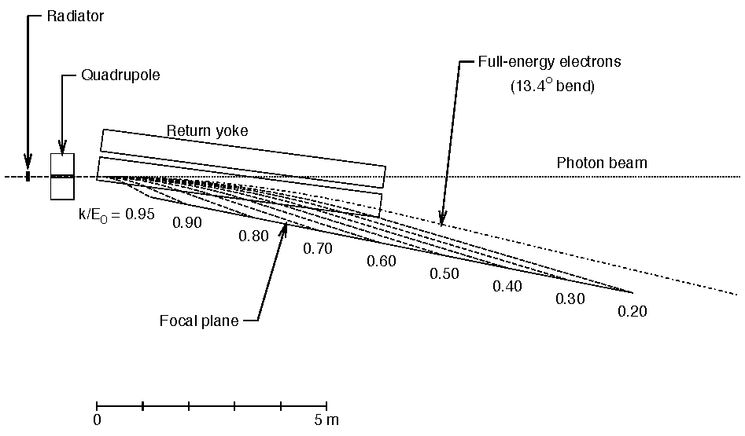
Magnet Requirements:
The magnet must bend the electron beam 13.4° to the dump
  Given 1.5 T then L_{eff} = 6.3m
The photon beam must pass through undisturbed
The shape of the field must allow accurate measurement of the electron energy along the focal plane.
DUMP

Slide 3
Spectrometer Requirements
Photon energy detection from 70 to 75% of E₀ (E₀=12 GeV ) with a resolution of at least 0.5%.
  For a 12 GeV beam this implies the photon energy range 8.4 to 9.0 GeV.
  Resolution set by physics and the GlueX momentum resolution.
  Detector capable of 5×10⁶ electrons/s per 0.1% of the above photon range.
Additional capability to detect photons in the range 25 to 97% of E₀ (3 to 11.7 GeV)

Slide 4
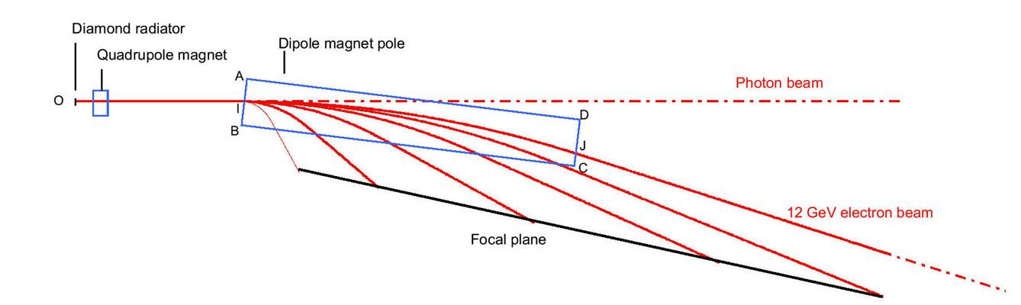
Uniform field optimization
Physicist view of the tagger
Tip angle θ
Distance I-B
Optimize distance I-B and magnet tip angle θ using TRANSPORT (Glasgow).
Best Results
  I-B = 210 mm and θ = 6.5 °
Monoenergetic beam
No detector effects
Perfect field

Slide 5
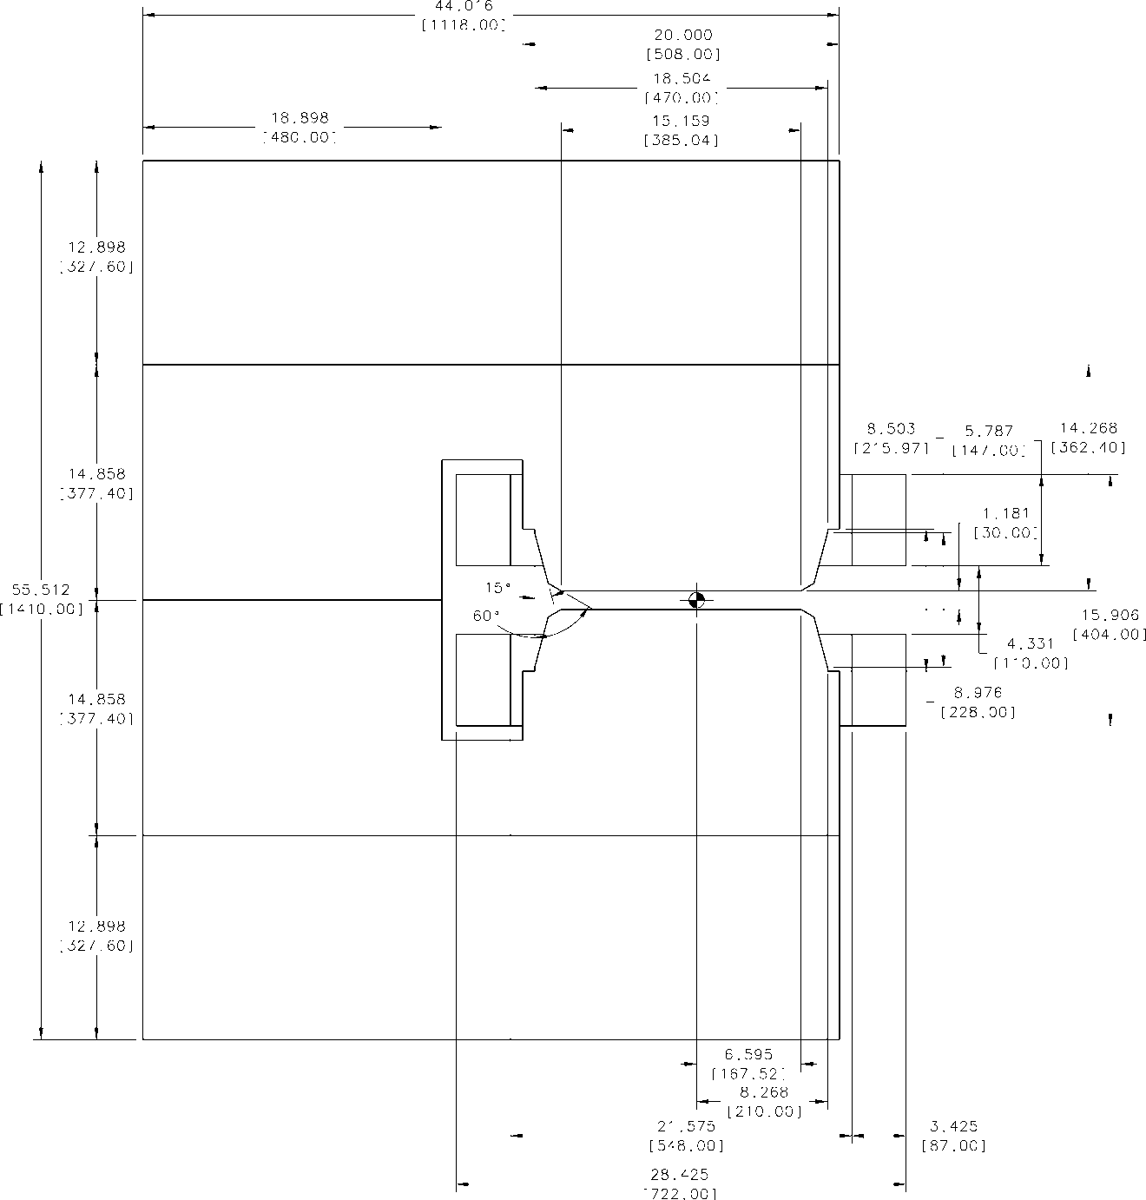
More Detailed Simulations
Magnet with the geometry shown on the right was modeled in TOSCA and ANSYS.
The computed fields agreed well with each other.
In TOSCA particles were tracked through the magnet and the image on the detector plane was determined.
The TOSCA field was inserted into GEANT and the tracking results were cross checked.

Slide 6
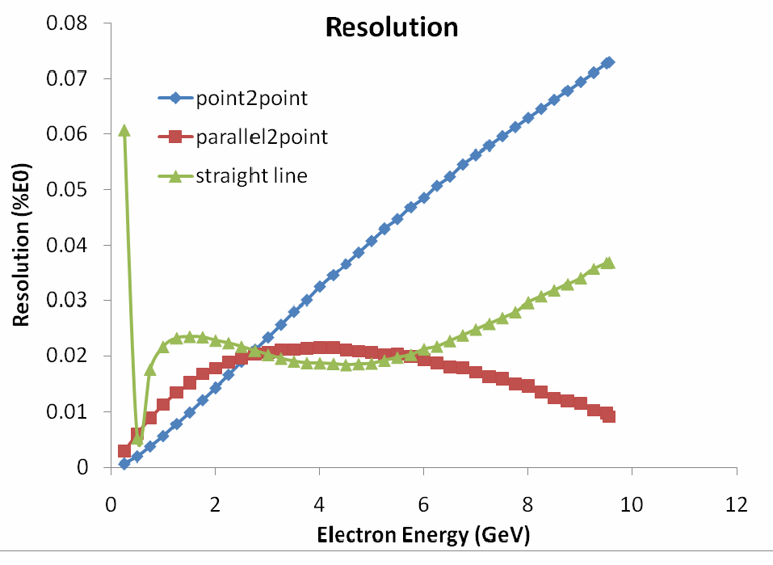
Excellent Intrinsic Resolution
TOSCA RESULTS
Resolution measured in percent of 12 GeV
Intrinsic resolution much better than 0.5% requirement from GlueX
Do not want to exclude future high precision experiments!

Slide 7
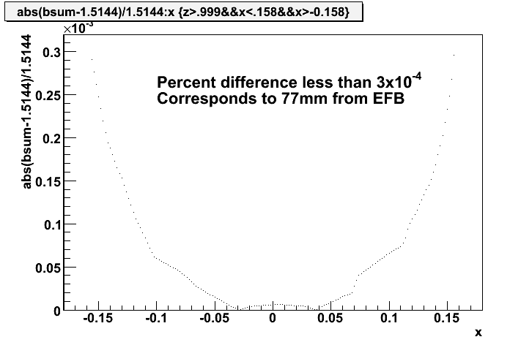
Use this design to set a uniformity Specification.
-x
77mm inside the EFB
Field uniform to 3*10⁻⁴ over +/- 180mm
Field Profile from ANSYS
(B_{central} – Bmod(x)/ B_{central} *10³
(m)

Slide 8
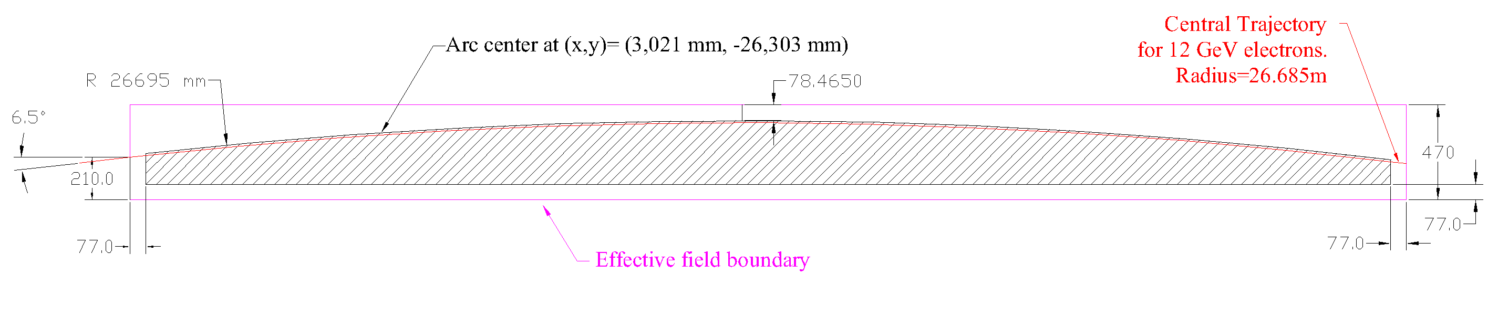
Uniform Field region
PLAN VIEW
(3021 mm, 26303 mm)
e⁻
(0,0)

Slide 9
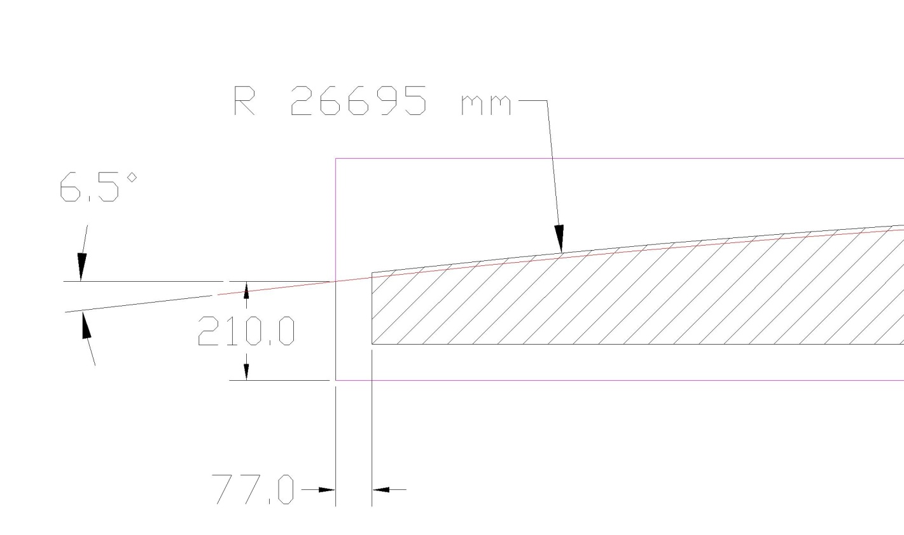
Uniform field region
Plan View
Uniform region 1cm outside beam trajectory.
Electron beam direction
Hatched region indicates uniform field region

Slide 10
Magnetic Technical Requirements
Requirement | Units | Value
Magnet Type |  | Normal conducting C-Magnet
Nominal magnetic field | T | 1.500
Maximum magnetic field | T | 1.80 (needed for hysteresis suppression)
Magnet Gap | mm | 30
Effective Length @1.5T | mm | 6300 ± 2
Distance to -x effective field boundary @1.5T | mm | 235± 2 Defined in drawing D00000-19-00-3002
Uniformity from simulations not including machining tolerances |  | Defined in drawing D00000-19-00-3002 3×10⁻⁴ over 100 mm length in uniform region within +/- 2mm of horiz. Plane
Global uniformity volume |  | Defined in drawing D00000-19-00-3002 Better than 1% in full uniform region

Slide 11
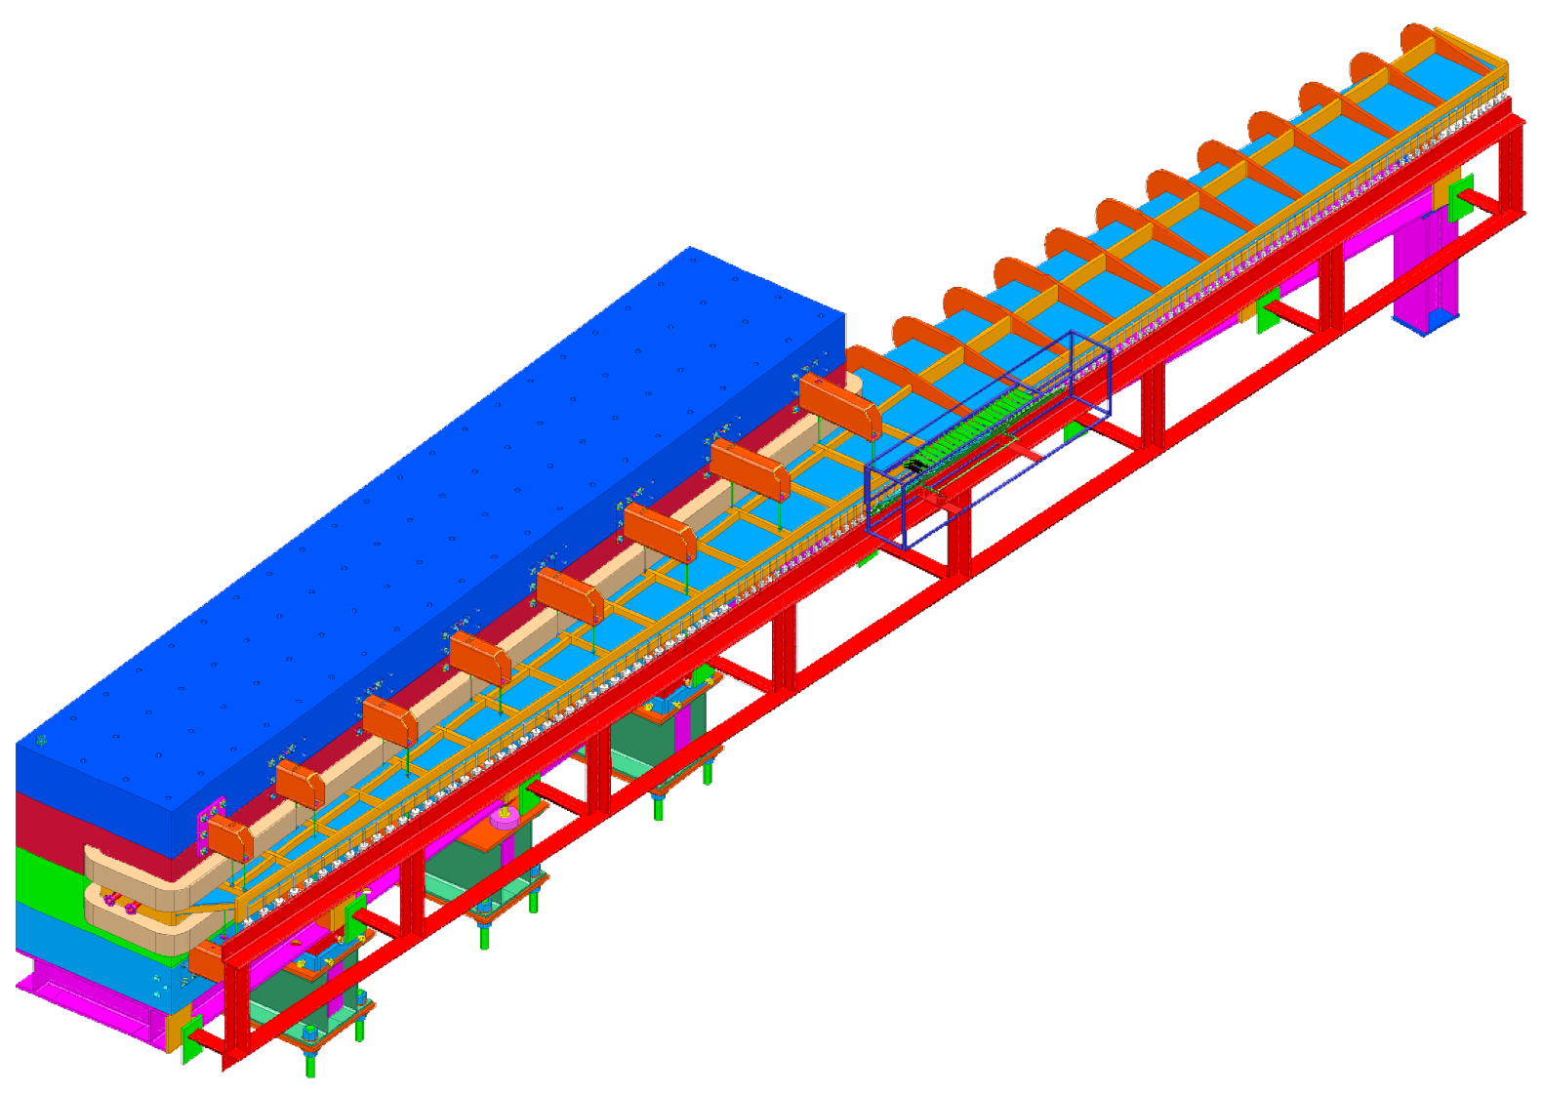
Tagger Magnet Nominal Design
1.5 T nominal field
1.1 m wide 1.4 m high 6.3 m long
  30 mm pole gap
Heaviest piece < 25 t
80 t total mass
12 GeV e⁻ bent 13.4 °
Electron measurement
  9 – 0.3 GeV electrons
  11.7 to 3 GeV photons
  ~0.04% E/E0 intrinsic resolution!

Slide 12
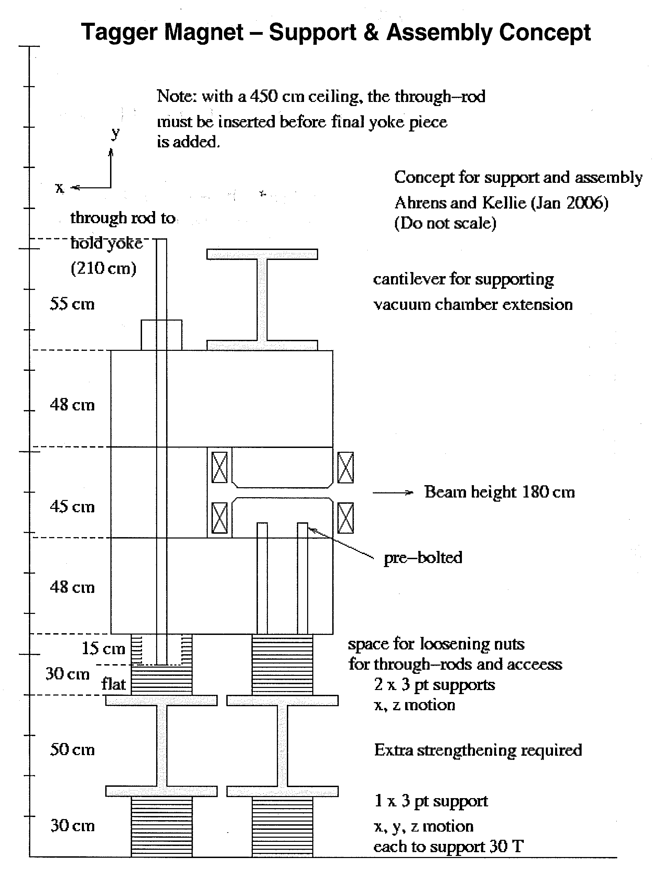
Mechanical Requirements
The magnet must fit in the hall.
  Requires a space requirements drawing.
  Checked largest truck can back to the hall doors.
  Must fit through the door.
It must be possible to assemble it.
  Plan to have a 25 t gantry crane over the magnet.
  Heaviest assembly must be under 25 t.
  Sufficient space is available
199 cm to the floor
Rod now ~ 158 cm long
251 cm to the floor
From Space Requirements document

Slide 13
Magnet Mechanical Requirements
Pole surface must be planar and parallel to ±0.1 mm without vacuum and magnetic loads.
Maximum deflection of the pole surfaces due to magnetic and vacuum forces < 0.15mm
The sealing surfaces to the vacuum chamber must be planar and parallel to ±0.2 mm.
No voids larger than 0.3˝ within 0.9˝ of the pole surface.
Material, heat treatment, and handling must be described at the time of the proposal.
Vacuum wetted surfaces must be Ni plated.
Fiducial features must be mounted as specified.
Materials must be documented and the pieces marked.

Slide 14
Mechanical Requirements - Stands
Must have correct height.
Adjustment capability ± 10 mm hor. ± 9 mm vert.
Minimum factor of 3 safety
Documentation detailing safety analysis
Welding in accordance with AWS D1.1
Features to mount the detector package must be provided above the alignment cartridges
  Needs described on an interface drawing.

Slide 15
Coil Requirements
Requirements | Units | Value
Coil Mechanical Requirements |  | Drawings D00000-19-00-2010 and D00000-19-00-2010 Winding scheme, fittings, brazing, material, flags, fittings, and klixon should be on drawing.
Maximum Design Temperature | °C | 95
Maximum operating temperature | °C | 80
Maximum water pressure | PSI | 120
Maximum water supply pressure drop | PSI | 100
Maximum flow rate | GPM | 46
Maximum water flow velocity | ft/sec | 8
Maximum voltage drop across all coils connected in series for 1.8 T | V | 220
Maximum Current | A | 400

Slide 16
Material Specifications
I copied the specifications from Robin Wines’ specification #MAG0000000S0045 for the XP Dipole Magnet Coils.
The materials and quality control items were very well specified and I saw no reason why we should change this.
This means that only the dimensions of the copper, the array size, and the details of the terminations are left to the manufacturer. We need to specify the fittings and flag dimensions.

Slide 17
Vacuum Chamber Specifications
  No material inside the vacuum chamber envelope.
11.1 m window with no bracing which crosses the horizontal plane.
Must fit together and seal against the pole. Vacuum tight to 10⁻⁹ mbar l/s.
Safety according to ASME B&PV code section II.
Vacuum pumping ports according to ASME B&PV code section VIII or FEA calculation.
Vacuum ports for NMR probes must be provided.
Material DIN 1.4429 (SAE 316LN).

Slide 18
Vacuum Cham. Specifications cont.
  Welding and inspection specified in SOW
  Cleaning specified in SOW
  Require mechanical testing prior to assembly in the magnet.
  Lifting plan required for the chamber. Any tooling becomes property of JLAB.

Slide 19
Summary
The reference design magnet has been well simulated.
The requirements are well understood.
The requirements drawings are far from finished.

Slide 20
Backup

Slide 21
Manpower cost
Mech Eng $63.81 per hr
  63.81*40*(52/44)= $3.0 k per mw
    Fully burdened non-escalated effort
  Mech Designer $43.84 per hour
  $43.84 *40*(52/44)=$2.1 k per mw
    Fully burdened non-escalated effort

Slide 22
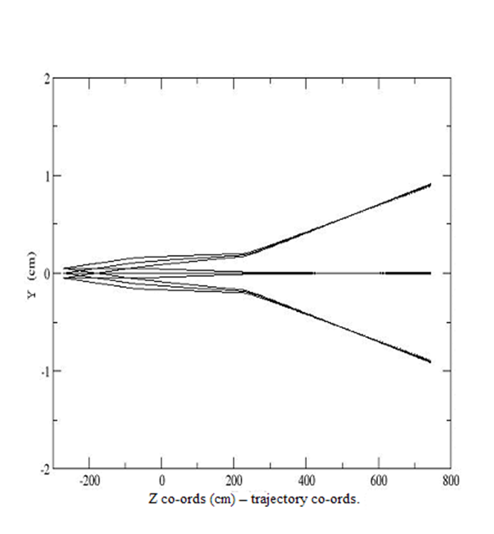
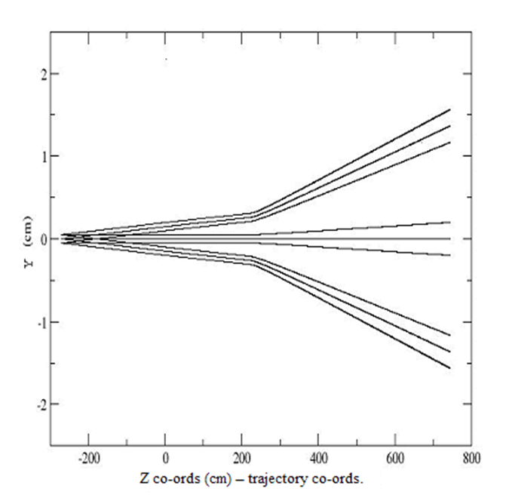

Slide 23
2. The effects of the magnetic properties of stainless steel on the tagger performance.
The stainless steel used for the tagger vacuum chamber wall should be non magnetic stainless steel.
Type 304 and type 316 stainless steel are the most common materials used in accelerators.
Machining and welding can alter the properties of these steels.
Care must be taken to avoid undesirable effects on the vacuum chamber and the magnetic field distribution.
(C. Weber and J. Fajans, Rev. Sci. Instrum., Vol. 69, No. 10, (1998) 3696)

