Slide 1
TAGGER MAGNET DESIGN
Presented by Tim Whitlatch

Slide 2
Tagger Area
Permanent Magnet
North Wall
AC ducts
Vacuum gages and pump
Beam Current Monitor
Photon Beamline
Beamline encasement to Hall D
Quad
Radiator
Vacuum Chamber
Electron dump
Tagger Magnet
Shielding
Truck ramp entrance

Slide 3
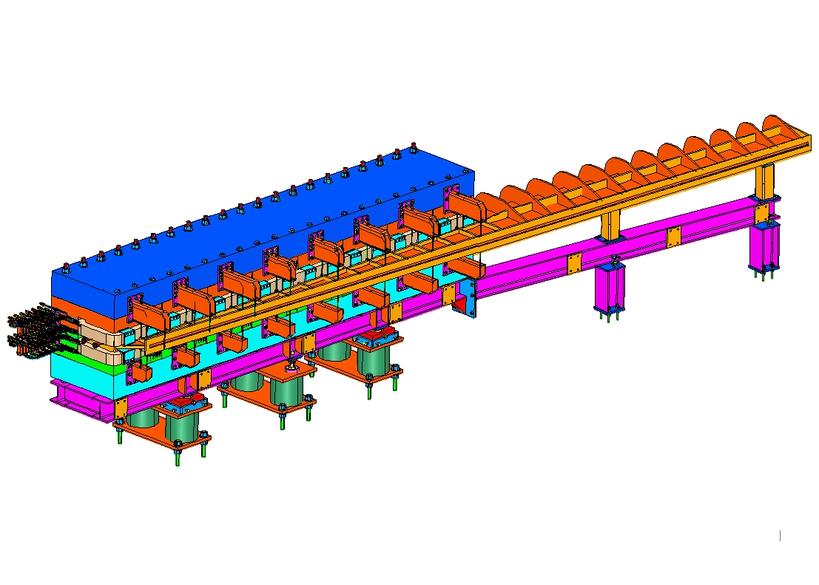
Tagger Components
Preloaded threaded rod
Vacuum chamber
Vacuum Chamber supports
Magnet steel
Hodoscope frame attach points
Coils
Tagger support stands
Tagger strong back

Slide 4
Tagger Cross-Section
Adjustment cartridges use wedge type for vertical
Sliders for X-Z
+/- 1cm horizontal plane adjustment
+/-9mm vertical adjustment (standard part)
Each piece under 25 tons
Provision for porta-power for alignment
Vacuum chamber and pole form integral vacuum space
Adjustment cartridges

Slide 5
Magnet Cross-Section from Yang’s TOSCA (early version)
Rowgoski contour all edges
Gap machined to within ±.004 inches
All steel 1006 annealed

Slide 6
Vacuum Chamber Support
Support tubes
Vacuum Chamber
O-ring Support rods
Window opening Support rods
Window opening 45mm x 11.2 m

Slide 7
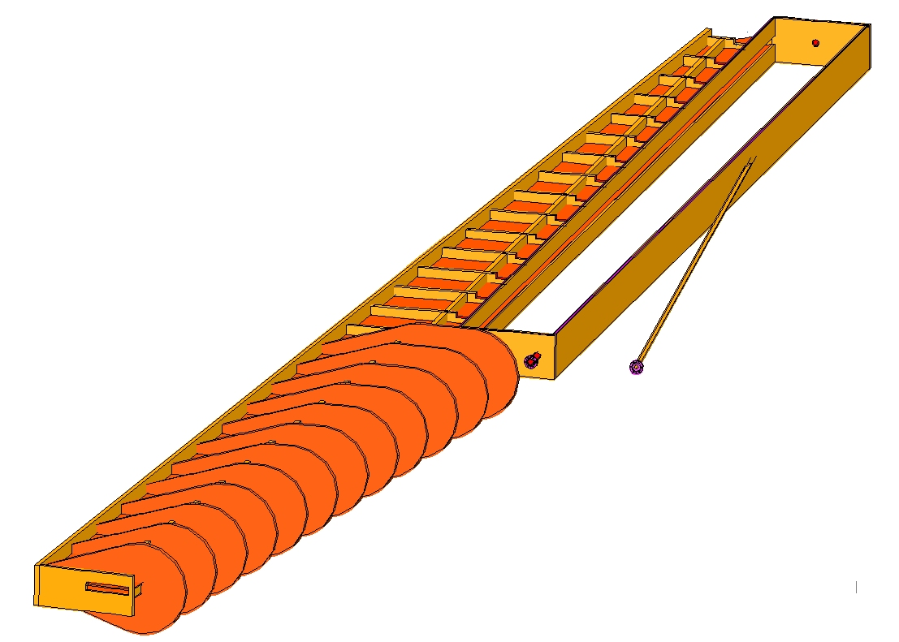
Vacuum Chamber
Beam
O-ring groove along entire edge, top and bottom
Skin, 0.25 inch plate
Photon beam tube
12GeV electron beam exit opening
Additional port for mag field probes both ends (location TBD due to synchrotron radiation)
Add vacuum pumping port (not shown)
Stiffening ribs 1 inch plate

Slide 8
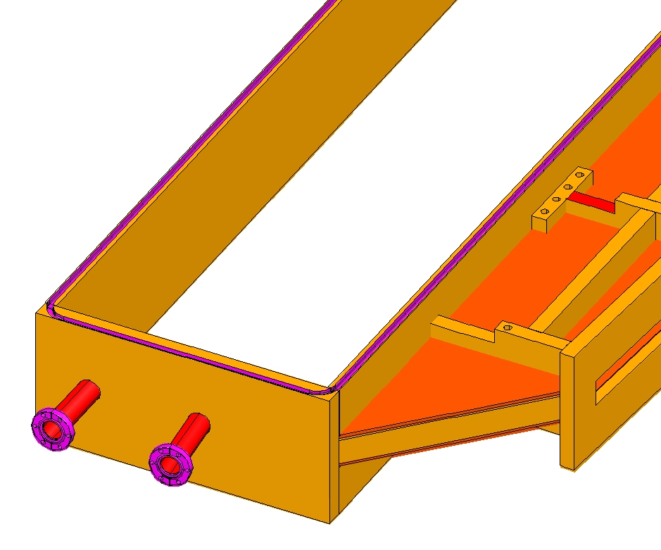
O-ring Groove (3/8)
Generous Radii (1.3 in) for better sealing
Support features
Thicker flange for radius of o-ring groove
Port for mag field probes both ends
Beam tube
Thin window
Add pumping port
Beam

Slide 9
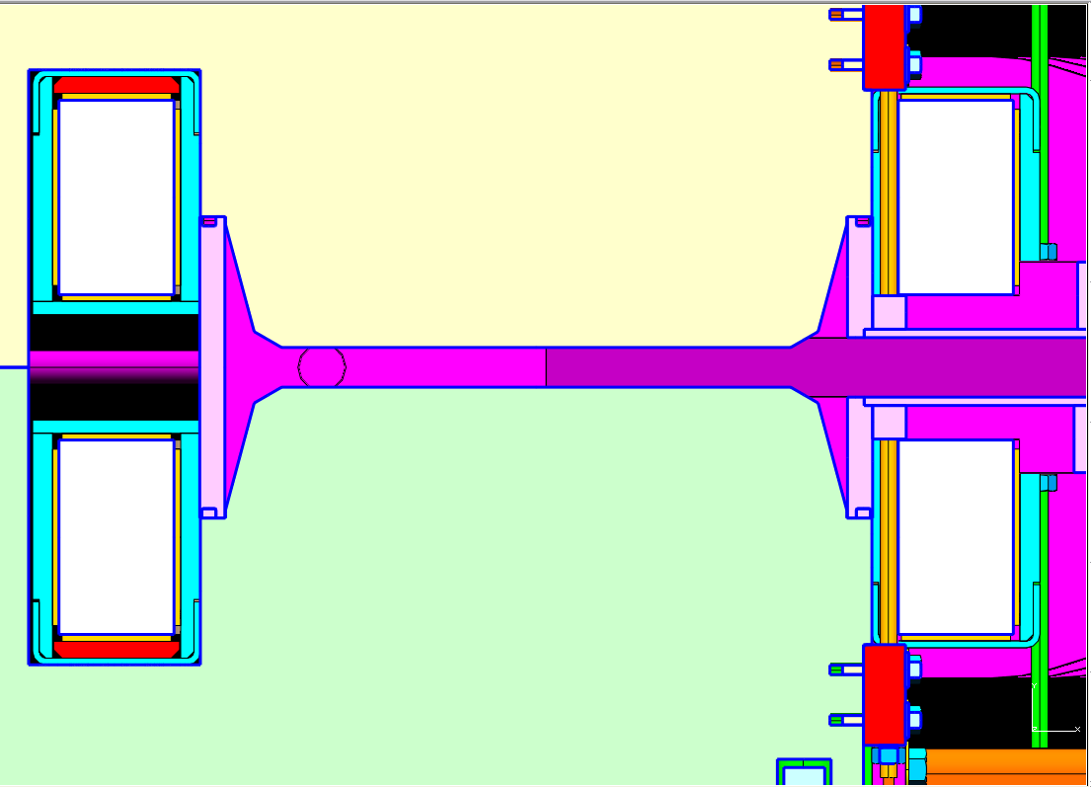
Vacuum Seal Details
Support rod
Coil
Upper pole
Vacuum Chamber back wall
30mm gap
O-ring
Lower pole
Pole tip

Slide 10
Vacuum Chamber Exit
45mm x 11.2 m window opening (thin window)
25 x 4.5 cm 12GeV electron beam opening
2.5 cm thick flange

Slide 11
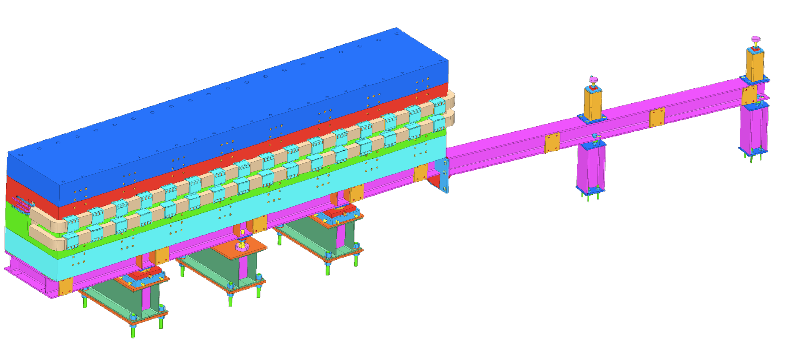
Coils
Magnet Coils
12 by 7 cu/epoxy matrix.
11 mm sq cu
7 mm water path
1.5 T→ 220A 105V
1.8 T→ 366A 200V
6.509 m
548 mm

Slide 12
Coils Connections
Magnet Coils Electrical
Series
1.8 T→ 366A 200V
0.52 ohms
Klixons and electrical flag connections needed
Plexiglass shield for safety
Magnet Coils Cooling
28 parallel circuits LCW
34GPM
8°C∆T
6.5 ft/sec
Tubes brazed together to form series circuit

Slide 13
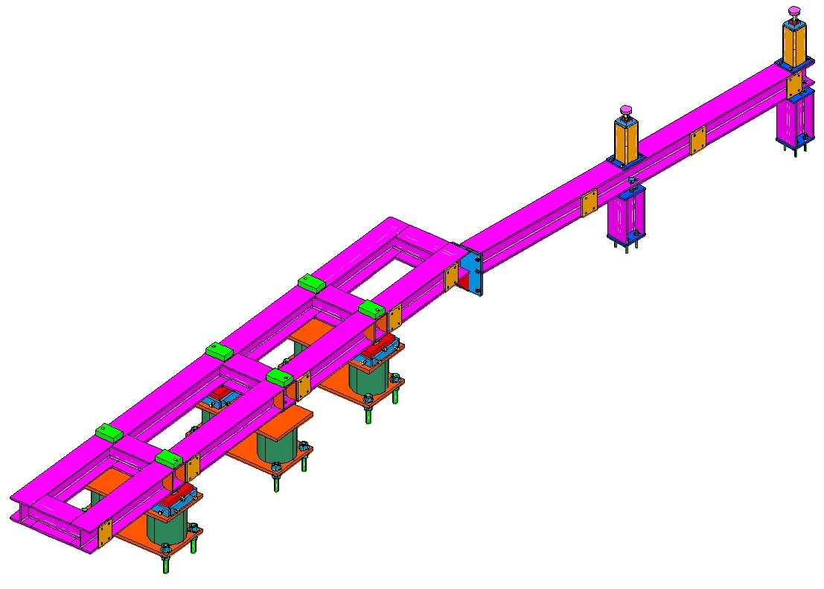
Tagger Support
I-beam strongback
3-point adjustment
±9mm vertical adjustment
±1cm x-y adjustment
Vacuum chamber support
Stands grouted in place after alignment
Final magnet alignment after install
Strongback
Hodoscope attach points
Adjustment cartridges
Vacuum Chamber supports
Base stands

Slide 14
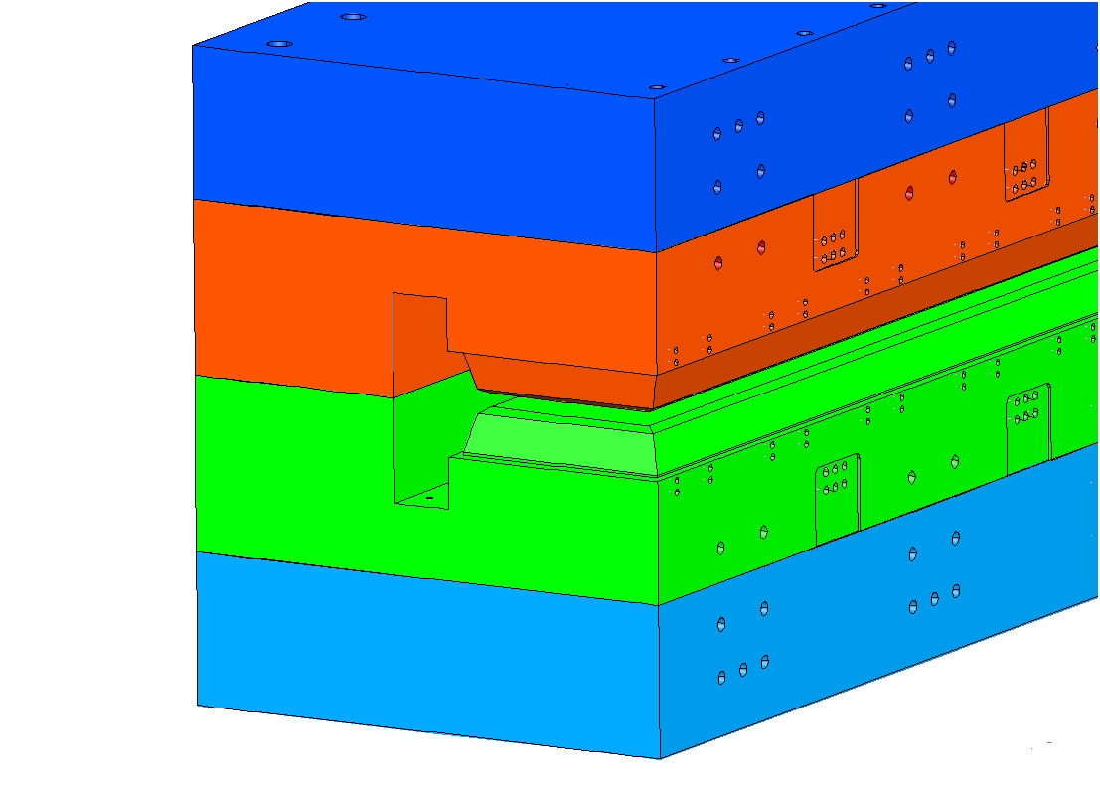
Tagger Alignment
Use optical means to determine relation between pole edges and fiducials on each slab within 50 microns
Laser tracking fiducial targets on tagger magnet to position relative to monuments within 40 microns
Targets visible after install on upstream end
Optically sight pole edges

Slide 15
Status of 3D Model
Magnet mostly modeled (needs coil support features)
Coil attach and layout needs to be complete
Vacuum chamber needs flange and window attach features
Support stands and adjustment mechanisms need more detail
Need to add jacking and alignment features to magnet steel

Slide 16
What Needs to be done?
Finalize analysis on vacuum chamber and stand
Finalize hodoscope attachment
Analyze magnet support structure
Complete coil support design
Complete coil electrical/cooling design
Finalize tagger spec and SOW
Produce complete design drawings for tagger components
Procure/manufacture components
Detail installation procedure
Write analysis tech note (pressure system and structural)
Perform ES&H detailed analysis
Develop detailed plan for mapping
Thin window design
Look at ¼” o-ring

