Slide 1




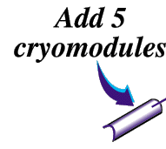


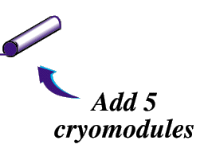
The JLab 12GeV Upgrade
12 GeV CEBAF
Upgrade magnets and power supplies
Add 5
cryomodules
CHL-2
Add arc
Two 1.1GV linacs
Add 5
cryomodules
Enhanced capabilities
in existing Halls
Notes:
help me

Slide 2
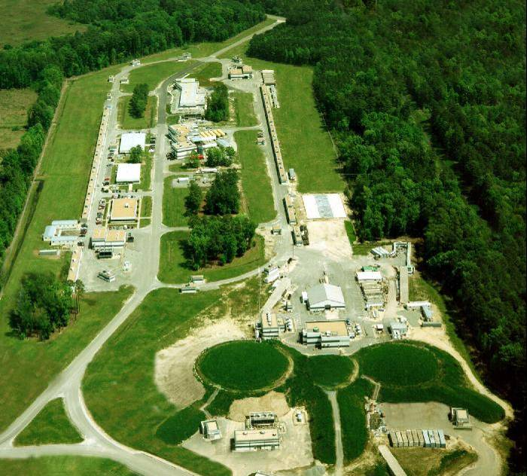
JLAB Today
JLAB in 2011
N
Hall D
Complex
A
C
B
Existing Experimental Halls

Slide 3
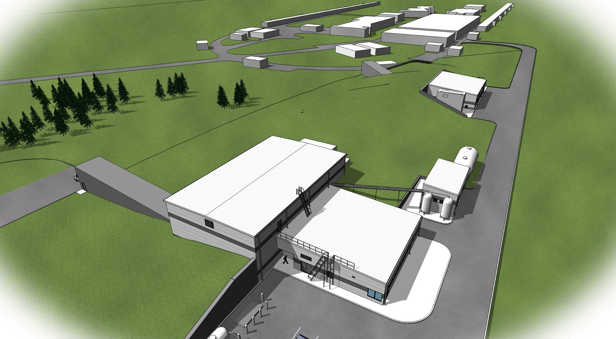
Rendering of Hall D Complex – Overhead View
Existing Facilities
Service Building
Hall D
Counting House
Cryo Plant
N

Slide 4
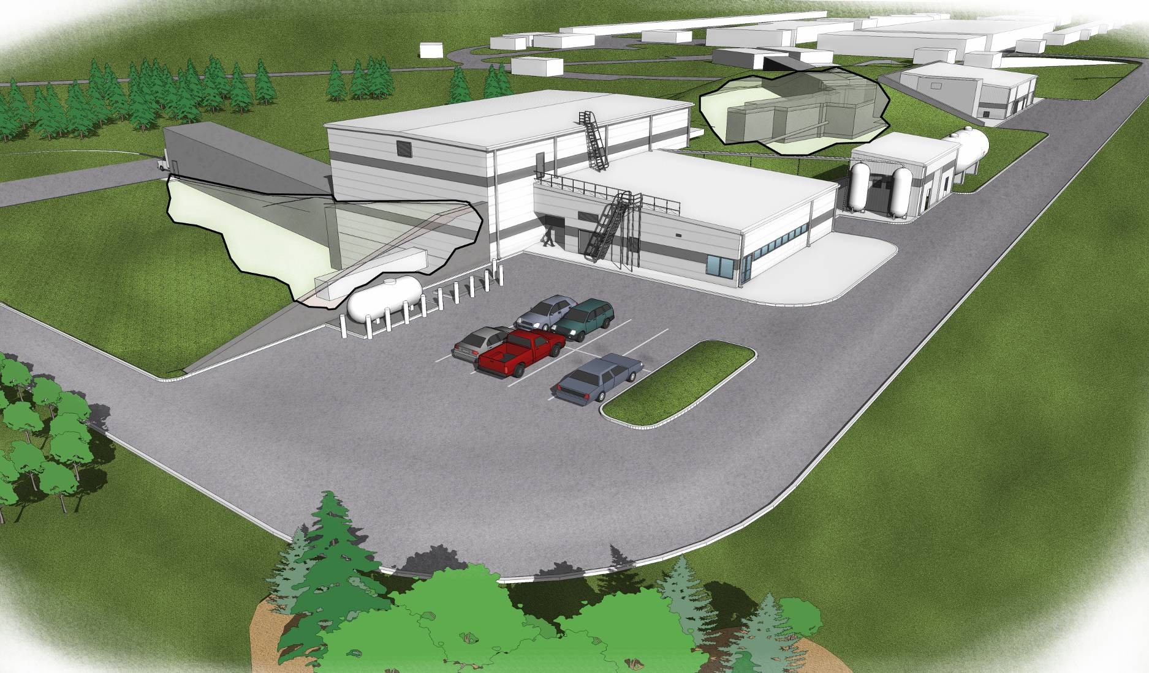
Hall D Complex
Hall D
Counting House
Service Building
Cryo Plant
Tagger Area w/ Electron Beam Dump
Photon Beam Dump
N

Slide 5
Hall D Complex – Site Plan from Drawings
Service Building
(Power Supplies, LCW equipment)
Counting House
Connection to existing tunnel
Cryogenics Plant
Collimator Enclosure
Photon Pipe
(10” concrete encased pipe)
Tagger Area
Hall D
Electron Beam Dump
Truck Access to Tagger Area
Truck Access to Hall D
Hall D Complex Drawings A001

Slide 6
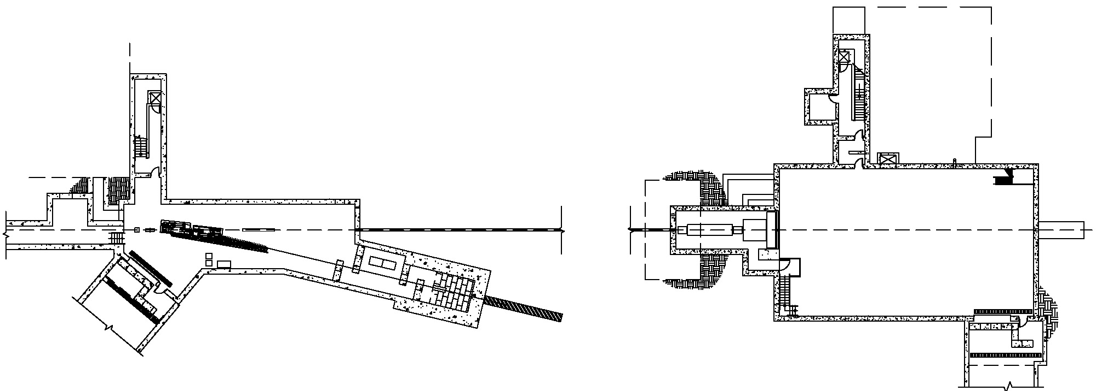
Photon beam and experimental area
Tagger
area
Hall D
North linac
Electron
Beam dump
East arc
Counting
House
Radiator
Coherent Bremsstrahlung
photon beam
Pair
Spectrometer
Photon
Beam dump
Top View
75 m
Solenoid-
Based detector
Collimator
Electron beam / dump
Tagger Area
Collimator Cave
Experimental
Hall D

