Slide 1
Tagger Magnet Requirements
Jim Stewart (JLAB)
Internal Magnet Review
May 2009

Slide 2
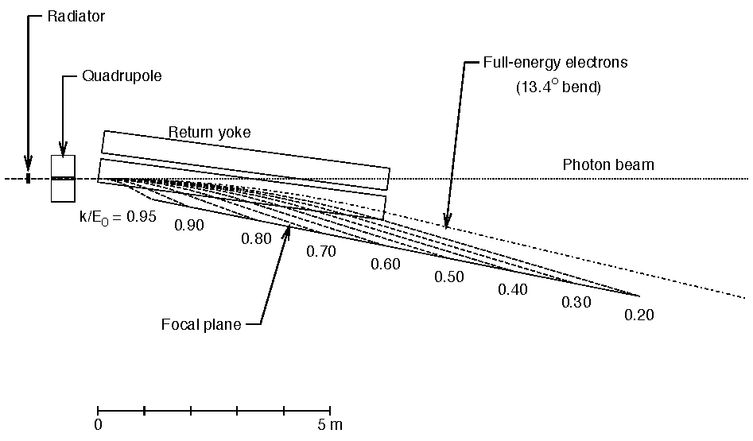
Magnet Requirements:
The magnet must bend the electron beam 13.4° to the dump
  Given 1.5 T then L_{eff} = 6.3m
The photon beam must pass through undisturbed
The shape of the field must allow accurate measurement of the electron energy along the focal plane.
DUMP

Slide 3
Spectrometer Specification
Photon energy detection from 70 to 75% of E0 with a resolution of 0.5%.
  For a 12 GeV beam this implies the photon energy range 84. to 9 GeV.
  Resolution set by physics and the GlueX momentum resolution.
Detector capable of 5×10⁶ electrons/s per 0.1% of the above photon range.
Additional capability to detect photons in the range 25 to 97% of E₀ (3 to 11.7 GeV for E₀=12 GeV)

Slide 4
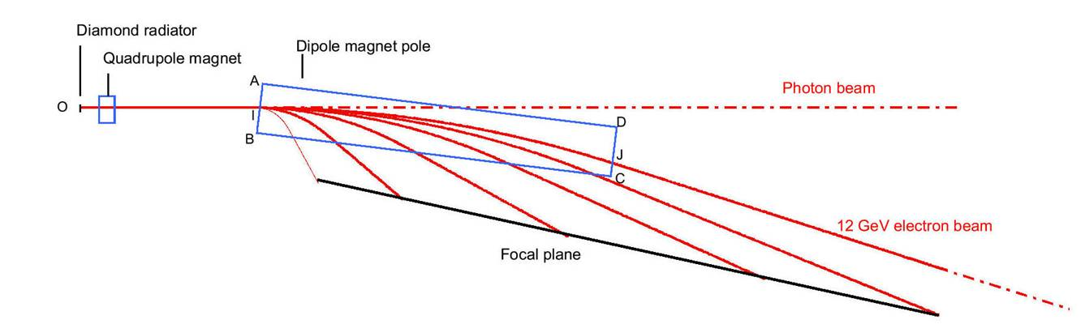
Uniform field optimization
Physicist view of the tagger
Tip angle θ
Distance I-B
Optimize distance I-B and magnet tip angle θ using transport (Glasgow).
Best Results
  I-B = 210 mm and θ = 6.5 °

Slide 5
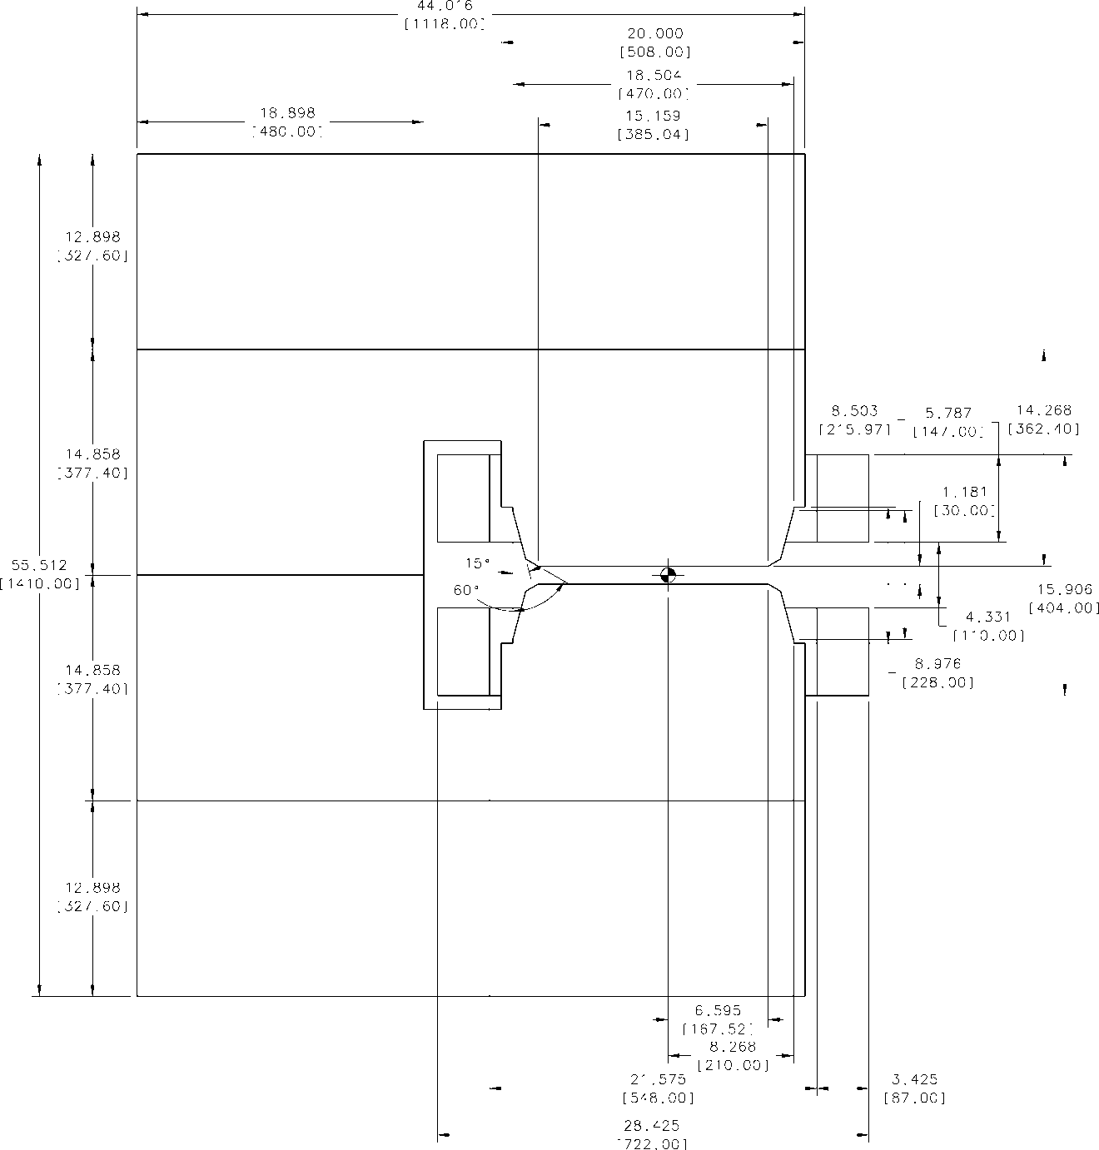
More Detailed Simulations
Magnet with the geometry shown on the right was modeled in Tosca and ANSYS.
The computed fields agreed well with each other.
In TOSCA particles were tracked through the magnet and the image on the detector plane was determined.
The TOSCA field was inserted into GEANT and the tracking results were cross checked.

Slide 6
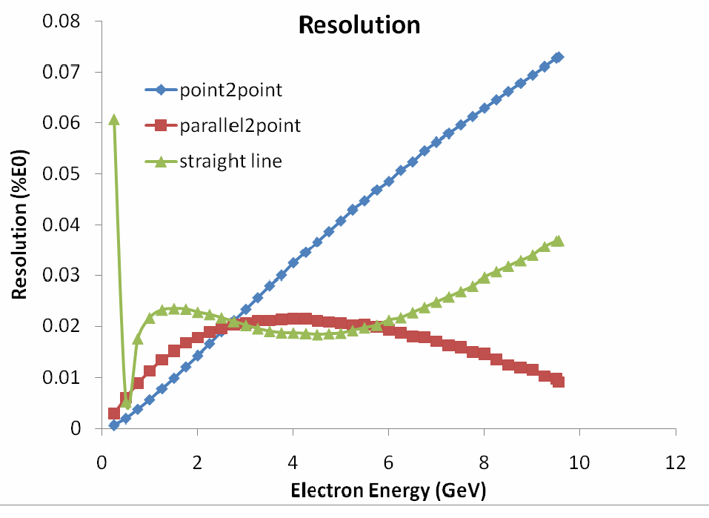
Excellent Intrinsic Resolution
Achievable
TOSCA RESULTS
Intrinsic resolution much better than 0.5% requirement from GlueX
Do not want to exclude future high precision experiments!

Slide 7
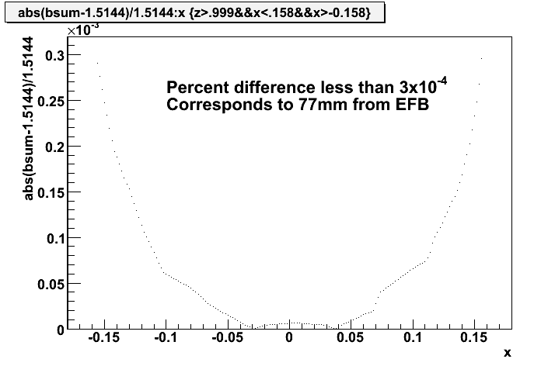
Use this to set a uniformity Spec!
Zoom in on central field region.
Plot the fractional change in the field relative to the central field.
Determine that 77 mm in from the Effective Field Boundary (EFB) the uniformity has reached the level of 3×10⁻⁴.
This resulted in the following uniformity SPEC.
Field Profile from ANSYS

Slide 8
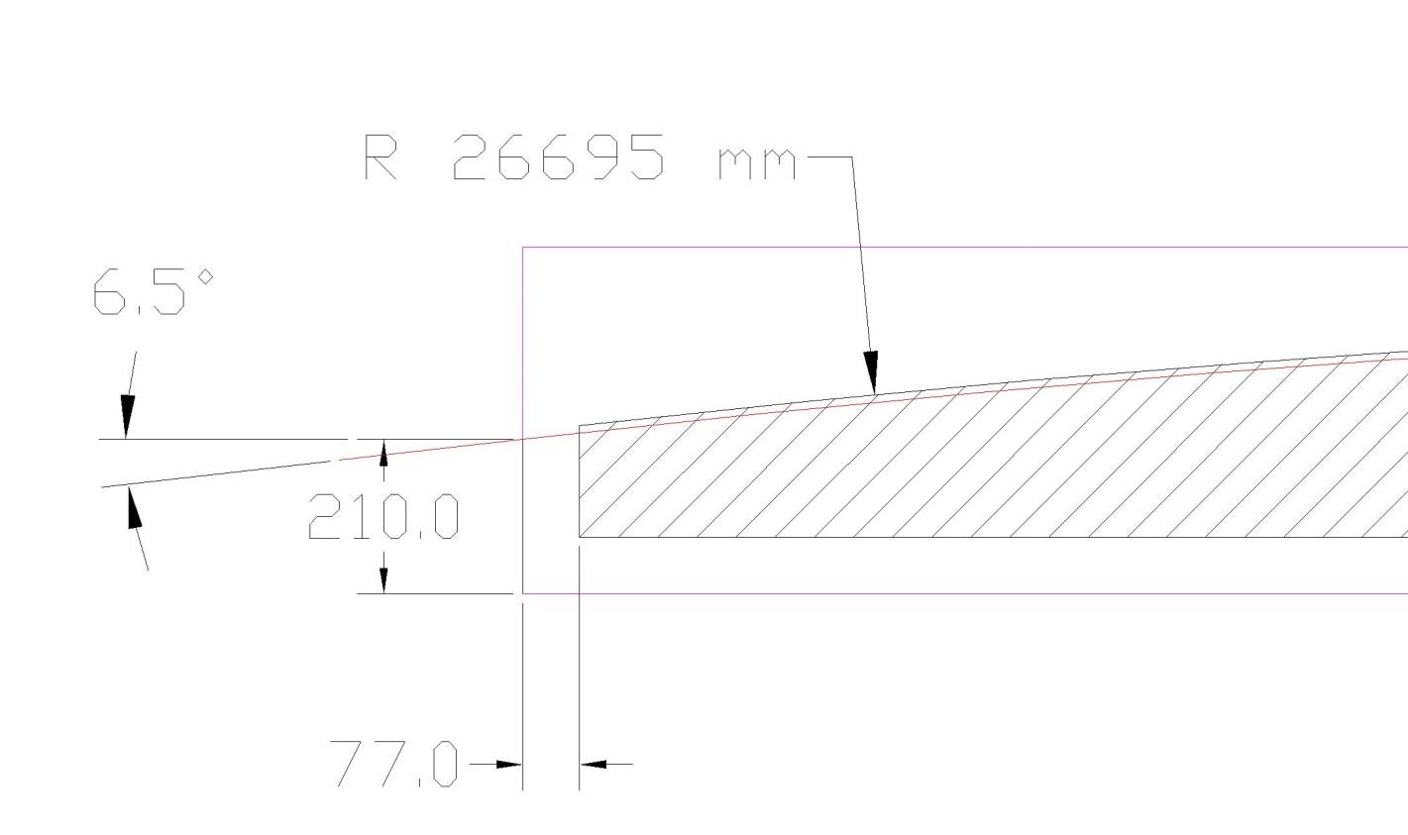
Uniform field region
Uniform region 1cm outside beam trajectory.

Slide 9
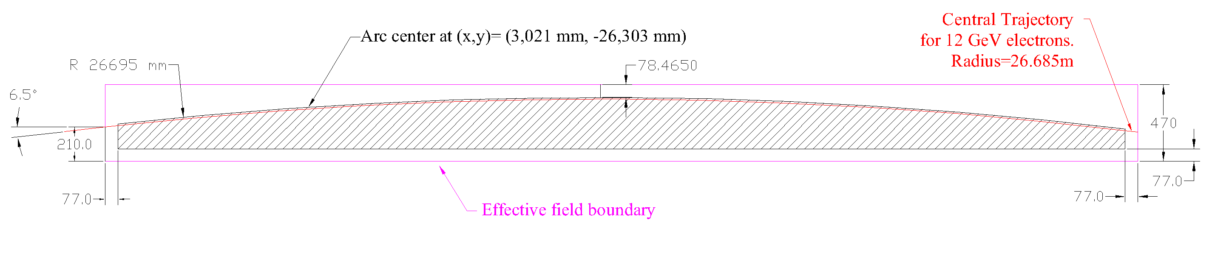
Uniform Field region

Slide 10
Magnetic Technical Requirements
Requirement | Units | Value
Magnet Type |  | Normal conducting C-Magnet
Nominal magnetic field | T | 1.500
Maximum magnetic field | T | 1.80 (needed for hysteresis suppression)
Magnet Gap | mm | 30
Effective Length @1.5T | mm | 6,300 ± 2
Distance to -x effective field boundary @1.5T | mm | 235± 2 Defined in drawing D00000-19-00-3002
Local uniformity volume |  | Defined in drawing D00000-19-00-3002 3×10⁻⁴ over 100 mm length in uniform region within +/- 2mm of horiz. plane
Global uniformity volume |  | Defined in drawing D00000-19-00-3002 Better than 1% in full uniform region

Slide 11
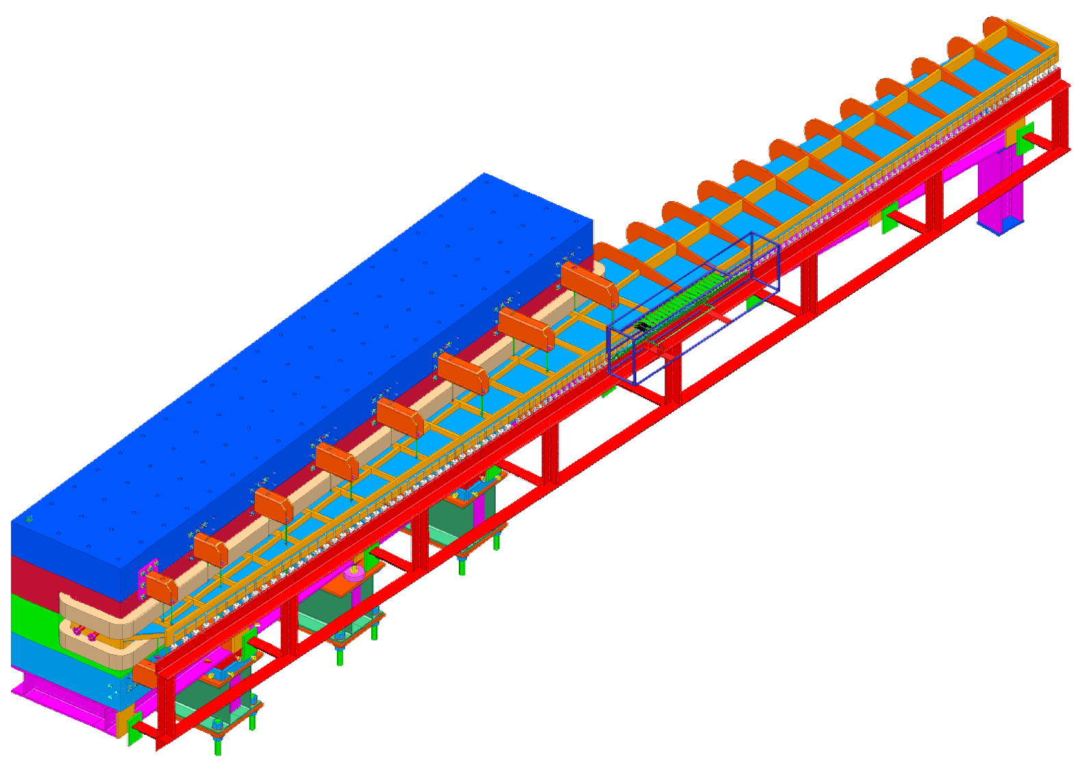
Tagger magnet design
1.5 T nominal field
1.1 m wide 1.4 m high 6.3 m long
  30 mm pole gap
Heaviest piece < 25 t
80 t total mass
12 GeV e⁻ bent 13.4 °
Electron measurement
  9 – 0.3 GeV electrons
  11.7 to 3 GeV photons
  ~0.02% E/E0 intrinsic resolution!

Slide 12
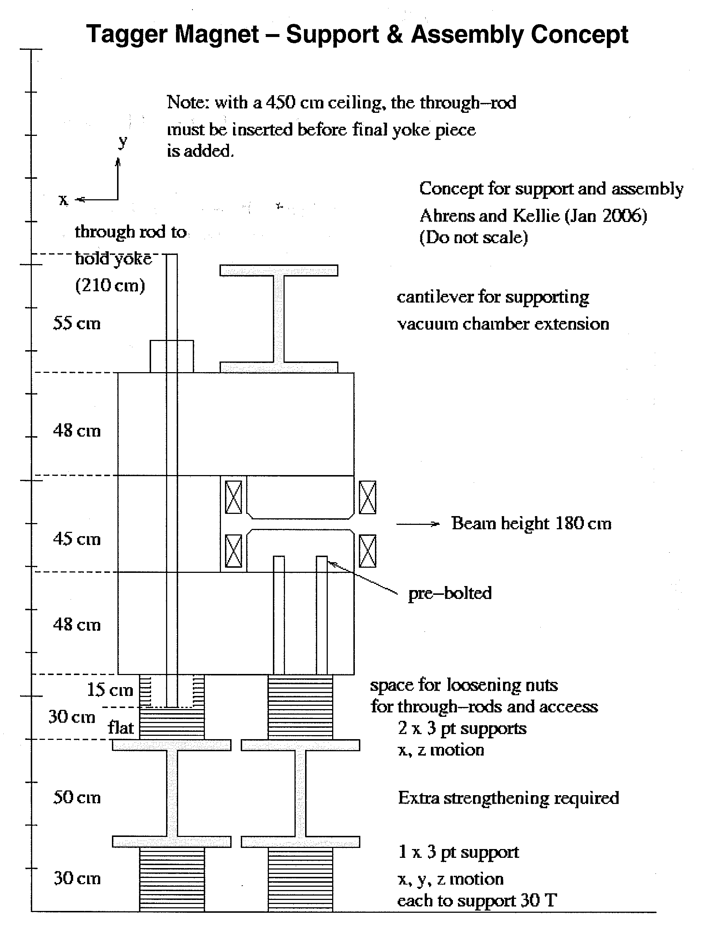
Mechanical Requirements
The magnet must fit in the hall.
  Requires a space requirements drawing.
It must be possible to assemble it.
  Plan to have a 25 t gantry crane over the magnet.
  Heaviest assembly must be under 25 t.
Must fit in the hall.
  Checked largest truck can back to the hall doors.
199 cm to the floor
Rod ~ 196 cm long
251 cm to the floor
From Space Requirements document

Slide 13
Magnet Mechanical Requirements
Pole surface must be planar and parallel to ±0.1 mm.
The sealing surfaces to the vacuum chamber must be planar and parallel to ±0.2 mm.
No voids larger than 0.3˝ within 0.9˝ of the pole surface.
Material, Heat treatment, and handling must be described at the time of the proposal.
Vacuum wetted surfaces must be Ni plated.
Fiducial features must be mounted as specified.
Materials must be documented and the pieces marked.

Slide 14
Mechanical requirements - Stands
Must have correct height.
Adjustment capability ± 10 mm hor. ± 9 mm vert.
Minimum factor of 3 safety
Documentation detailing safety analysis
Welding in accordance with AWS D1.1
Features to mount the detector package must be provided above the alignment cartridges
  Needs described on an interface drawing.

Slide 15
Coil Requirements
Requirements | Units | Value
Coil Mechanical Requirements |  | Drawings D00000-19-00-2010 and D00000-19-00-2010 winding scheme, fittings, brazing, material. Flags, fittings and klixon should be on drawing.
Maximum Design Temperature | °C | 95
Maximum operating temperature | °C | 80
Maximum water pressure | PSI | 120
Maximum water supply pressure drop | PSI | 100
Maximum flow rate | GPM | 20
Maximum water flow velocity | ft/sec | 8
Maximum voltage drop across all coils connected in series for 1.8 T | V | 170 ?? 220V
Maximum Current | A | 400

Slide 16
Material specifications
I copied the specifications from Robin Wines’ specification #MAG0000000S0045 for the XP Dipole Magnet Coils.
The materials and quality control items were very well specified and I saw no reason why we should change this.
This means that only the dimensions of the copper, the array size, and the details of the terminations are left to the manufacturer. We need to specify the fittings and flag dimensions.

Slide 17
Vacuum Chamber Requirements
  No material in the path of electrons in the energy range 9 – 0.3 GeV electrons
  11.1 m window with no bracing which crosses the horizontal plane.
Must fit together and seal against the pole. Vacuum tight to 10⁻¹¹ mbar l/s.
Safety according to ASME B&PV code section II.
Vacuum pumping ports according to ASME B&PV sode section VIII or FEA calculaction.
Material DIN 1.4429 (SAE 316LN)

Slide 18
Vacuum Cham. Requirements cont.
  Welding and inspectionSpecified in SOW
  Cleaning specified in SOW
  Require mechanical testiing prior to assembly in the magnet.
  Lifting plan required for the chamber. Any tooling becomes property of JLAB.

Slide 19
Backup

Slide 20
Manpower cost
Mech Eng $63.81 per hr
  63.81*40*(52/44)= $3.0 k per mw
    Fully burdened non-escalated effort
  Mech Designer $43.84 per hour
  $43.84 *40*(52/44)=$2.1 k per mw
    Fully burdened non-escalated effort

Slide 21
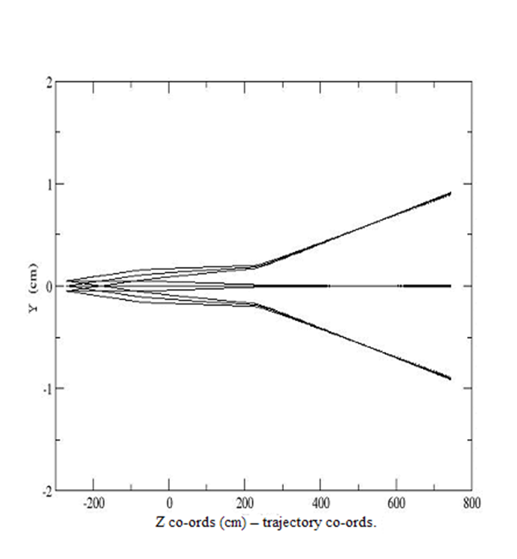
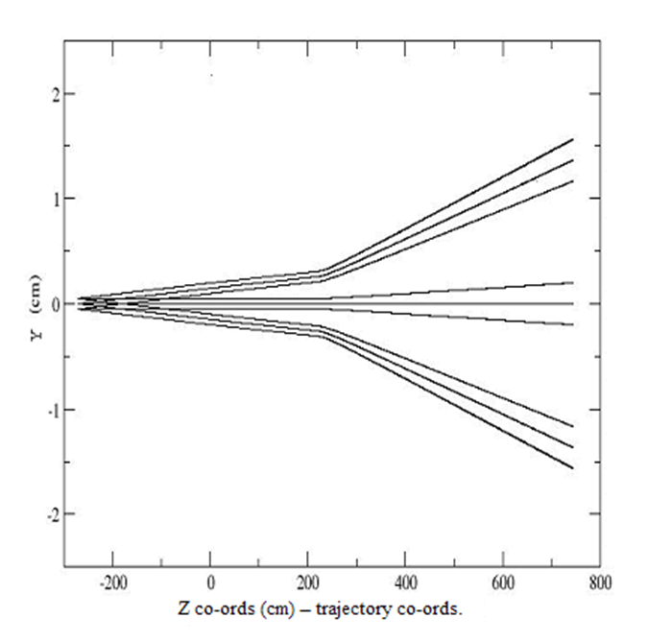

Slide 22
2. The effects of the magnetic properties of stainless steel on the tagger performance.
The stainless steel used for the tagger vacuum chamber wall should be non magnetic stainless steel.
Type 304 and type 316 stainless steel are the most common materials used in accelerators.
Machining and welding can alter the properties of these steels.
Care must be taken to avoid undesirable effects on the vacuum chamber and the magnetic field distribution.
(C. Weber and J. Fajans, Rev. Sci. Instrum., Vol. 69, No. 10, (1998) 3696)

