Slide 1
HDGeant4 development update
GlueX Collaboration Meeting, Newport News, Oct. 8-10, 2015
Richard Jones – University of Connecticut
integration with JANA
validation of tracking in magnetic field
new event sources (besides particle gun)
event-level parallelism with geant4.10
remaining milestones

Slide 2
HDGeant4 project: work plan
slide from collaboration meeting, Oct 2013
Download and install a recent stable release of G4
Create a template from one of the standard examples
Design classes for geometry import from hdds
Implement geometry import from hdds
Make a set of scripts to generate some standard views of GlueX
Debug the hdds geometry and validate using standard views
Implement classes for reading and stepping through magnetic fields
Configure a robust physics list for GlueX simulations
Implement the particle gun event generator
Implement Monte Carlo event input from hddm stream
Implement and test the internal cobrems generator
Create and document standard control macros for a few common scenarios
Set up mechanisms for verbose tracking output
Implement classes for hits, truth collection and output
progress
so far
(10/2013)
Richard Jones, GlueX Collaboration Meeting, Newport News, Oct. 8-10, 2015

Slide 3
HDGeant4 project: work plan
Download and install a recent stable release of G4
Create a template from one of the standard examples
Design classes for geometry import from hdds
Implement geometry import from hdds
Make a set of scripts to generate some standard views of GlueX
Debug the hdds geometry and validate using standard views
Implement classes for reading and stepping through magnetic fields
Configure a robust physics list for GlueX simulations
Implement the particle gun event generator
Implement Monte Carlo event input from hddm stream
Implement and test the internal cobrems generator
Create and document standard control macros for a few common scenarios
Set up mechanisms for verbose tracking output
Implement classes for hits, truth collection and output
progress
as of
5/2015
Richard Jones, GlueX Collaboration Meeting, Newport News, Oct. 8-10, 2015

Slide 4
HDGeant4 project: work plan
Download and install a recent stable release of G4
Create a template from one of the standard examples
Design classes for geometry import from hdds
Implement geometry import from hdds
Make a set of scripts to generate some standard views of GlueX
Debug the hdds geometry and validate using standard views
Implement classes for reading and stepping through magnetic fields
Configure a robust physics list for GlueX simulations
Implement the particle gun event generator
Implement Monte Carlo event input from hddm stream
Implement and test the internal cobrems generator
Create and document standard control macros for a few common scenarios
Set up mechanisms for verbose tracking output
Implement classes for hits, truth collection and output
regress
as of
5/2015
significant
updates required
revised
and validate against hdgeant3
Richard Jones, GlueX Collaboration Meeting, Newport News, Oct. 8-10, 2015

Slide 5
HDGeant4 project: work plan
Download and install a recent stable release of G4
Create a template from one of the standard examples
Design classes for geometry import from hdds
Implement geometry import from hdds
Make a set of scripts to generate some standard views of GlueX
Debug the hdds geometry and validate using standard views
Implement classes for reading and stepping through magnetic fields
Configure a robust physics list for GlueX simulations
Implement the particle gun event generator
Implement Monte Carlo event input from hddm stream
Implement and test the internal cobrems generator
Integrate G3-style user simulation options (control.in)
Implement and test event-level parallelism with G4 version 10
Use verbose tracking output to validate against hdgeant (G3)
Implement classes for hits, truth collection and output
regress
as of
5/2015
significant
updates required

Slide 6
HDGeant4 project: work plan
Download and install a recent stable release of G4
Create a template from one of the standard examples
Design classes for geometry import from hdds
Implement geometry import from hdds
Make a set of scripts to generate some standard views of GlueX
Debug the hdds geometry and validate using standard views
Implement classes for reading and stepping through magnetic fields
Configure a robust physics list for GlueX simulations
Implement the particle gun event generator
Implement Monte Carlo event input from hddm stream
Implement and test the internal cobrems generator
Integrate G3-style user simulation options (control.in)
Implement and test event-level parallelism with G4 version 10
Use verbose tracking output to validate against hdgeant (G3)
Implement classes for hits, truth collection and output
as of
10/2015

Slide 7
HDGeant4 project: work done
hdds geometry fixes
integration with JANA
validation of tracking in magnetic field
new event sources (besides particle gun)
event-level parallelism with geant4.10
creation of hits, truth collection and output

Slide 8
HDGeant4: quick start guide
$ mkdir myHDGeant4 && cd myHDGeant4
$ git clone git@github.com:rjones30/HDGeant4.git
$ source mysetup.sh [initialize JANA,G4 environment vars]
$ make
$ cd test
$ hdgeant4 -h
hdgeant4: invalid option -- 'h'
Usage: hdgeant4 [options] [<batch.mac>]
where options include:
-v : open a graphics window for visualization
-tN : start N worker threads, default 1
-rN : set run to N, default taken from control.in
Richard Jones, GlueX Collaboration Meeting, Newport News, Oct. 8-10, 2015

Slide 9
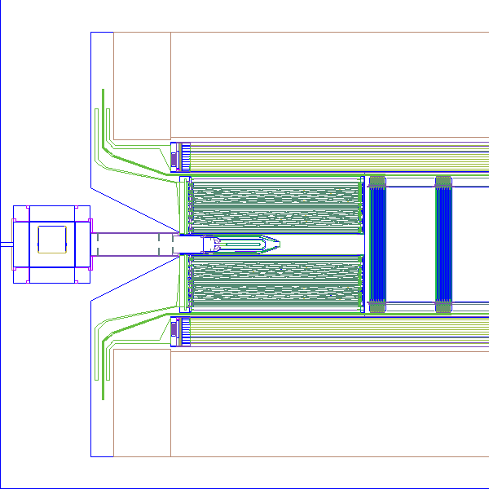
HDGeant4: quick start guide
$ hdgeant4 -v
############################################
!!! WARNING - FPE detection is activated !!!
############################################
*************************************************************
Geant4 version Name: geant4-10-01-patch-02 [MT] (19-June-2015)
<< in Multi-threaded mode >>
Copyright : Geant4 Collaboration
Reference : NIM A 506 (2003), 250-303
WWW : http://cern.ch/geant4
*************************************************************
JANA >>Created JCalibration object of type: JCalibrationCCDB
JANA >>Generated via: JCalibration using CCDB for MySQL and SQLite databases
JANA >>Run:9001
JANA >>URL: sqlite:////home/halld/ccdb/sql/ccdb-07-08-2015.sqlite
JANA >>context: default
JANA >>Reading Magnetic field map from Magnets/Solenoid/solenoid_1200A_poisson_20140520 ...
Nx=251 Ny=1 Nz=701 ) at 0x396b050
Reading fine-mesh B-field data from /home/halld/jana/resources/Magnets/Solenoid/finemeshes/solenoid_1200A_poisson_20140520.evio
. . .
Idle> /control/execute ../vis/stdviews/z65.mac
Richard Jones, GlueX Collaboration Meeting, Newport News, Oct. 8-10, 2015

Slide 10
HDGeant4: quick start guide
Idle> /tracking/verbose 2 Idle> /run/beamOn 1 ### Run 0 start. G4WT0 > ### Run 0 start. G4WT0 > ********************************************************************************************************* G4WT0 > * G4Track Information: Particle = chargedgeantino, Track ID = 1, Parent ID = 0 G4WT0 > ********************************************************************************************************* G4WT0 > Step# X Y Z KineE dEStep StepLeng TrakLeng Volume Process G4WT0 > 0 4.3197 mm -1.7414 mm 65.048 cm 191.31 MeV 0 eV 0 fm 0 fm LIH2:1 initStep G4WT0 > 1 9.6337 mm 2.5575 mm 64.675 cm 191.31 MeV 0 eV 7.7851 mm 7.7851 mm TGTV:1 Parallel World 1 G4WT0 > 2 9.743 mm 2.6448 mm 64.667 cm 191.31 MeV 0 eV 159.38 um 7.9445 mm TARG:1 Parallel World 1 G4WT0 > 3 3.1563 cm 1.9288 cm 63.171 cm 191.31 MeV 0 eV 3.1259 cm 3.9204 cm CYLW:1 Parallel World 1 G4WT0 > 4 3.9714 cm 2.5116 cm 62.625 cm 191.31 MeV 0 eV 1.1413 cm 5.0617 cm HALL::1:1 Parallel World 1 G4WT0 > 5 3.9722 cm 2.5122 cm 62.624 cm 191.31 MeV 0 eV 11.403 um 5.0628 cm LASS::1:1 CoupledTransportation G4WT0 > 6 5.7435 cm 3.7109 cm 61.458 cm 191.31 MeV 0 eV 2.436 cm 7.4988 cm STRT:1 Parallel World 1 G4WT0 > 7 5.7622 cm 3.7231 cm 61.446 cm 191.31 MeV 0 eV 255.35 um 7.5243 cm STIC:1 Parallel World 1 G4WT0 > 8 5.8324 cm 3.7687 cm 61.4 cm 191.31 MeV 0 eV 953.29 um 7.6196 cm STIE:1 Parallel World 1 G4WT0 > 9 5.8686 cm 3.7922 cm 61.377 cm 191.31 MeV 0 eV 491.08 um 7.6688 cm STIS:1 Parallel World 1 G4WT0 > 10 6.6548 cm 4.2932 cm 60.869 cm 191.31 MeV 0 eV 1.0619 cm 8.7306 cm STRT:1 Parallel World 1 G4WT0 > 11 6.6583 cm 4.2954 cm 60.866 cm 191.31 MeV 0 eV 46.755 um 8.7353 cm STAI:1 Parallel World 1 G4WT0 > 12 6.6597 cm 4.2963 cm 60.866 cm 191.31 MeV 0 eV 18.769 um 8.7372 cm STRC:4 Parallel World 1 G4WT0 > 13 6.914 cm 4.4548 cm 60.702 cm 191.31 MeV 0 eV 3.4123 mm 9.0784 cm STAO:1 Parallel World 1 G4WT0 > 14 6.9154 cm 4.4556 cm 60.701 cm 191.31 MeV 0 eV 18.767 um 9.0803 cm STWR:1 Parallel World 1 G4WT0 > 15 6.9578 cm 4.4819 cm 60.674 cm 191.31 MeV 0 eV 568.68 um 9.1371 cm STRT:1 Parallel World 1 G4WT0 > 16 6.9973 cm 4.5063 cm 60.649 cm 191.31 MeV 0 eV 528.68 um 9.19 cm STTD:1 Parallel World 1 G4WT0 > 17 7.0016 cm 4.5089 cm 60.646 cm 191.31 MeV 0 eV 56.861 um 9.1957 cm STRT:1 Parallel World 1 :
Richard Jones, GlueX Collaboration Meeting, Newport News, Oct. 8-10, 2015

Slide 11
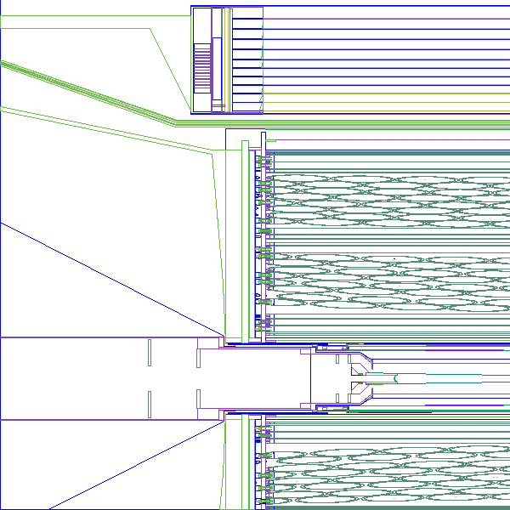
HDGeant4: quick start guide
Idle> /vis/viewer/update
/vis/viewer/update
Window activated for picking (left-mouse), exit (middle-mouse).
(0.000282113,0.350656,52.8405) found in LIH2 copy 1 of LIH2 with
complete path: /Parallel World 1:0/HALL:1/TARG:1/TGTV:1/LIH2:1
layer 1 material: LiqHydrogen
magnetic field (Tesla): -6.19202e-07,-0.000769645,1.40196
(0.000282113,17.9358,35.9994) found in STLA copy 1 of STLA with
complete path: /Parallel World 1:0/HALL:1/LASS:1/CDC:1/DCLS:1/STLM:18/STLA:1
layer 1 material: CDchamberGas
magnetic field (Tesla): -1.00951e-06,-0.0641812,1.31078
(0.000282113,42.8821,10.01) found in CDRO copy 1 of CDRO with
complete path: /Parallel World 1:0/HALL:1/LASS:1/CDC:1/CDRO:1
layer 1 material: SignalCables
magnetic field (Tesla): -1.72224e-06,-0.261786,1.12881
(0.000282113,77.8479,33.2965) found in BMF7 copy 1 of BMF7 with
complete path: /Parallel World 1:0/HALL:1/LASS:1/BCAL:1/sd08:12/BCAM:1/BCK7:1/sd0f:1/BCA7:1/BMF7:1
layer 1 material: leadScint
magnetic field (Tesla): 0,0,1e-96
Richard Jones, GlueX Collaboration Meeting, Newport News, Oct. 8-10, 2015

Slide 12
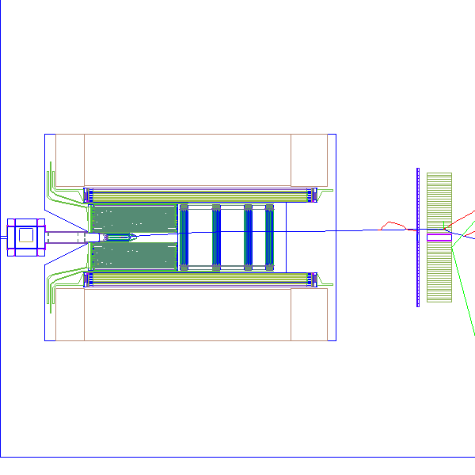
HDGeant4: quick start guide
Idle> /control/execute ../vis/stdviews/z65.mac
Idle> /vis/viewer/zoom 0.5
Idle> /vis/viewer/set/targetPoint 0 0 280 cm
Idle> /vis/scene/add/trajectories smooth
Idle> /run/beamOn 1
G4WT0 > >>> Event 1
G4WT0 > 1059 trajectories stored in this event.
G4WT0 > Thread-local run terminated.
G4WT0 > Run Summary
G4WT0 > Number of events processed : 1
G4WT0 > User=0.23s Real=0.26s Sys=0.01s
Run terminated.
Run Summary
Number of events processed : 1
User=0.25s Real=0.26s Sys=0.01s
WARNING: 1 event has been kept for refreshing and/or reviewing.
"/vis/reviewKeptEvents" to review them.
Window activated for picking (left-mouse), exit (middle-mouse).
Richard Jones, GlueX Collaboration Meeting, Newport News, Oct. 8-10, 2015

Slide 13
HDGeant4: status and outlook
geometry, fields and event sources fully implemented
event-level parallelism now works with Geant 4.10
project freely available for checkout on github
build works on centos 6, standard distro
user beware -- pre-alpha release
check it out and try it!
hits prototype under construction
not yet checked in
cdc will be released first
work continues in parallel with other efforts
Richard Jones, GlueX Collaboration Meeting, Newport News, Oct. 8-10, 2015

